Slide 1
Actualizing Caplan -
Developing Historical Perspectives on Human Progress

Slide 2
The Myth of the Rational Voter
Bryan Caplan – George Mason University
Caplan identifies four systematic biases in economics among the populace
The Anti-Market Bias
The Anti-Foreign Bias
The Make-Work Bias
The Pessimistic Bias
Notes:
Winner of the 2008 Silver Independent Publisher Book Medal, Current Events Category
Caplan makes the convincing case that noneconomists suffer from four prevailing biases: they underestimate the wisdom of the market mechanism, distrust foreigners, undervalue the benefits of conserving labor, and pessimistically believe the economy is going from bad to worse. This last one is called “The pessimistic bias” and it is the one I focus on today.

Slide 3
“The Pessimistic Bias”
A tendency to overestimate the severity of economic problems and underestimate the (recent) past, present, and future performance of the economy
“The Good Old Days” Fallacy - People make a mistake when they idealize the conditions in the past
Failure to understand the speed and scope of human progress from not only an economic or material perspective, but in numerous other measures of quality of life
Notes:
Really a problem with developing the scope to observe long-term trends. What I am going to do in this paper is to specifically address the underestimation problem. I believe it comes from a lack of understanding of history and given the sad state of the study of history in the k-12 and 12-16 systems. In the K-12 system history has fallen out of favor in many states as they focus on readin’, writin’ and ‘rithmetic. At the university level, history has been taken over by the left. The focus is not on humankind but rather balkanized and separate groups focusing on the perspectives of each group.
Idealization
“Humanity's fall from Grace”
Biblical allusions to banishment from the Garden of Eden
The loss of pastoral life
“Crude materialism” among other banalities
Capitalism made life much improved for whom? The masses. The story from the Marxists, Communists and Socialists (one in the same) is that the masses are exploited by capitalism.
Linked to anti-capitalists and the politics of Communism vs. Capitalism that clearly still exists today. Von Mises – The Anti-Capitalist Mentality
All of these affect the politics prism through which people view their world. If you believe the dooms day scenarios about the future you view government action in one way, if you don’t -- you view it another way. If you have a good knowledge of living conditions in the past you may be less likely to damn the current state of affairs. And less likely, I believe, to fall for the massive action through the state to repair and fix us.
Not knowing the history creates fertile ground for demagogues to use the “Chicken Little” fallacy.
HOW MANY KNOW THE FABLE OF CHICKEN LITTLE?
An old fable in which “chicken little” is hyper-alarmed and throughout the fable he runs around yelling “The sky is falling, the sky is falling!” There are a couple of morals embodied in the fable but the most important one here is this: "do not believe everything you are told".

Slide 4
Melancholic Americans
Fairbank, Maslin, Maullin, Metz & Associates (2010)
68% of Americans believe that the “American Dream” will be “harder” for their children to achieve
45% rated it as “much harder”
Only 32% believe that America is on the rise while 58% believe it is in decline
When queried on the current condition of the “American Dream” on a scale of “1-10”
only 5% of survey respondents rated the highest score (10)
the number choosing “7” through “10” matched the number choosing “1”
mean score was “4.5”
Interestingly, first and second generation immigrants, African Americans and Latinos were consistently more positive.

Slide 5
The Ehrlich - Simon Bet
Paul Ehrlich – Biologist
The Population Bomb, 1968
“the battle to feed all of humanity is over ... In the 1970s and 1980s hundreds of millions of people will starve to death in spite of any crash programs embarked upon now."
"India couldn't possibly feed two hundred million more people by 1980," or "be self-sufficient in food by 1971.“
Notes:
In the 1970s, Paul Ehrlich, a neo-Malthusian biologist, argued that excessive consumption was producing shortages of natural resources. Economist Julian Simon responded that, for the foreseeable future, the operations of the market and of human ingenuity would be so successful that not only would shortages be avoided, but prices of natural resources could actually be expected to fall.
Simon bet that the price of any set of raw materials would be lower ten years from now than it was today. Ehrlich and his supporters took up the challenge and, in October 1980, chose five metals: chrome, copper, nickel, tin, and tungsten.
Simon won the bet as, by October 1990, the composite price index of these five metals had fallen by more than 40 percent. Simon was humble in victory, however, noting that because metal prices are volatile, he could quite easily have lost. His theory was that raw material prices would trend down in the long-run, not necessarily in a period as short as ten years.

Slide 6
Years of Oil Remaining: Proven Reserves/Annual World Consumption
Notes:
If we were right in 1980 then we sho9ld have run out of oil in 2008. Thank goodness they were wrong, eh?!?!

Slide 7
Joseph Schumpeter
Electric lighting is no great boon to anyone who has money enough to buy a sufficient number of candles and to pay servants to attend them. It is the cheap cloth, the cheap cotton and rayon fabric, boots, motorcars and so on that are the typical achievements of capitalist production, and not as a rule improvements that would mean much to a rich man. Queen Elizabeth owned silk stockings. The capitalist achievement does not typically consist in providing more silk stockings for queens but in bringing them within the reach of factory girls in return for steadily decreasing amounts of effort.
CSD, 67.
CSD: ——— (1950), Capitalism, Socialism, and Democracy, 3rd ed. (New York: Harper and Brothers), orig. pub. 1942.
Notes:
Schumpeter was probably the greatest economic historian of the 20th century. He left many legacies but one is his understanding of the role that capitalism played in lifting the masses out of deep, structural poverty.
Base our perspective in the reality for nearly all human beings on this planet. The world has seen a massive increase in the standard-of-living of huge subsets of population. There are numerous measures we can use and are used. The progress is stunning and it is false and disingenuous to ignore it.
I maintain that the focus ought to be – yes, OUGHT TO BE – on Human Flourishing.
The big question in economic history is this: How did mankind go from subsistence to phenomenal progress in the span of about 300 years?
It is true that the progress has not been “equitably distributed” around the world, though there is substantial absolute progress in nearly all places (more on that later.) But is the issue distribution? Or is the issue to try to understand how some advanced a thousand-fold and others only a hundred-fold? This is what development economics is about. I maintain that to really understand development economics one must have a historical framework based upon reality.

Slide 8
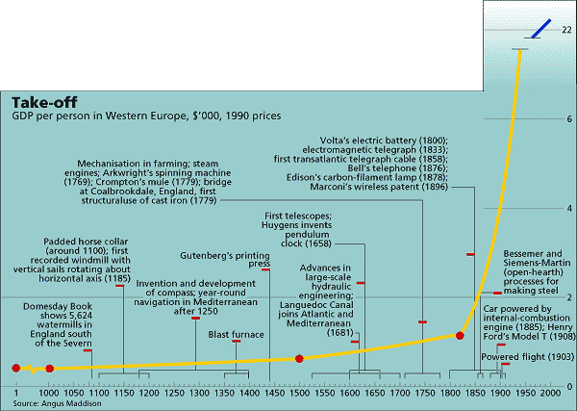
Notes:
HERE is the “Hobbs hockey stick curve”!
Source: Economist Magazine
Point out the axes, major events.

Slide 9
Ludwig von Mises The Anti-capitalist Mentality
“The emergence of economics as a new branch of knowledge was one of the most portentous events in the history of mankind. In paving the way for capitalistic enterprise it transformed within a few generations all human affairs more radically than the preceding ten thousand years had done. “
Notes:
I agree with Juliam Simon.
Page 21, Ludwig von Mises, The Anti-capitalist Mentality, edited and with a preface by Bettina Bien Greaves (Indianapolis: Liberty Fund, 2006).
Accessed from http://oll.libertyfund.org/title/1889 on 2010-02-18

Slide 10
Battle Field Surgery
Who was the best surgeon in the Civil War?
Notes:
This is how I introduce the entire topic in my courses.
I have a question for you to answer and we will see how many have read any American Civil War history.
Read the question, don’t answer it immediately and reflect upon it for 30 seconds.
Now - write down an answer in one or two sentences.
WAIT ONE-HALF MINUTE AND WRITE
GO TO NEXT SLIDE

Slide 11
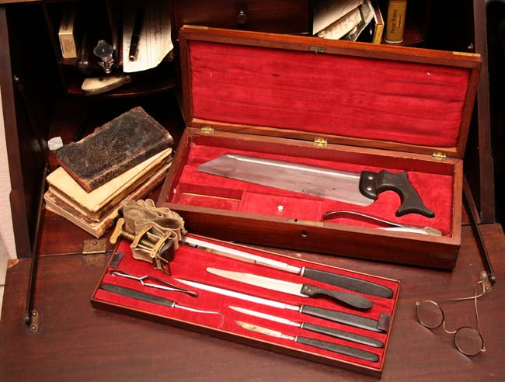
Notes:
Hint #1!
So what is your answer? I know mine!

Slide 12
The fastest surgeon
“…do it with as much quickness as possible, and therefore carry the knife all round the member with one sweep, the hand which holds the knife being carried round under the limb…”
Source: "The Practice of Surgery", by Samuel Cooper, and notes by Dr. Alexander H. Stevens. This book served as the "How To" guide for Civil War surgeons.
Notes:
“Before proceeding to the description of the methods of taking off limbs, let me just remind the reader of two lines, which convey a piece of general information of high value in this part of surgery, and constitute, as it were, one of the best fundamental rules for our guidance in the performance of amputation: "as little of the flesh should be cut away, as possible; but the more bone is removed, the better."
Source: "The Practice of Surgery", by Samuel Cooper, and notes by Dr. Alexander H. Stevens. This book served as the "How To" guide for Civil War surgeons.
Dr. Alton Deane Hobbs, my grandfather
b. 1898 and attended medical school at the University of Michigan in the 1920s. First “class” for anesthesiology at U of M in 1941-2. Primary drugs used?
Ether applied through gauze on a kitchen sieve.
I asked him once -- “What happens if they wake up?”
His response -- “More ether, son, more ether.”

Slide 13
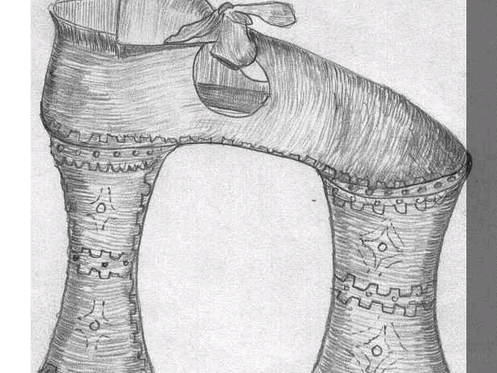
Zoccoli
What was their purpose?
Notes:
Zoccoli became fashionable in Europe during the 16th century as a method of keeping women’s feet out of the mud puddles in the street.
Throughout the major cities of the world there were problems with large amounts of manure in the streets –
“Nineteenth-century cities depended on thousands of horses for their daily functioning. All transport, whether of goods or people, was drawn by horses. London in 1900 had 11,000 cabs, all horse-powered. There were also several thousand buses, each of which required 12 horses per day, a total of more than 50,000 horses. In addition, there were countless carts, drays, and wains, all working constantly to deliver the goods needed by the rapidly growing population of what was then the largest city in the world. Similar figures could be produced for any great city of the time.*
The problem of course was that all these horses produced huge amounts of manure. A horse will on average produce between 15 and 35 pounds of manure per day. Consequently, the streets of nineteenth-century cities were covered by horse manure. This in turn attracted huge numbers of flies, and the dried and ground-up manure was blown everywhere. In New York in 1900, the population of 100,000 horses produced 2.5 million pounds of horse manure per day, which all had to be swept up and disposed of. (See Edwin G. Burrows and Mike Wallace, Gotham: A History of New York City to 1898 [New York: Oxford University Press, 1999]).

Slide 14
Horse Manure
World's first urban planning conference (1898) with a nearly singular focus on the problems associated with horses
Morris (2007) "American cities were drowning in horse manure as well as other unpleasant byproducts of the era’s predominant mode of transportation: urine, flies, congestion, carcasses, and traffic accidents.”

Slide 15
Horse Manure
The problem in 1880 was approximately 15,000 dead horses in New York City streets
Solution? Delay removal, allow the corpse to putrefy sufficiently to saw and transport the carcass
Problem in 1900 approximately 2,500,000 lbs. per day in New York City streets
Supply shift!
Prices for manure fell for agricultural purpose yielding piles on vacant lots 40 – 60 feet high

Slide 16
Fernand Braudel
“The two sides are clearly visible at first glance: luxury and poverty. Superabundance and penury.”
The Structures of Everyday Life, Civilization & Capitalism, 15th – 18th Century
Notes:
Braudel was a French Marxist who published an exhaustive documentation of life in Europe in the 15th – 18th century. He was, of course, using this to damn capitalism, but his observations, I think provide a significant defense of capitalism.
I agree with Braudel that the plight of the masses was a horrible one during most of this period – though this changed dramatically in the 19th and 20th centuries.

Slide 17
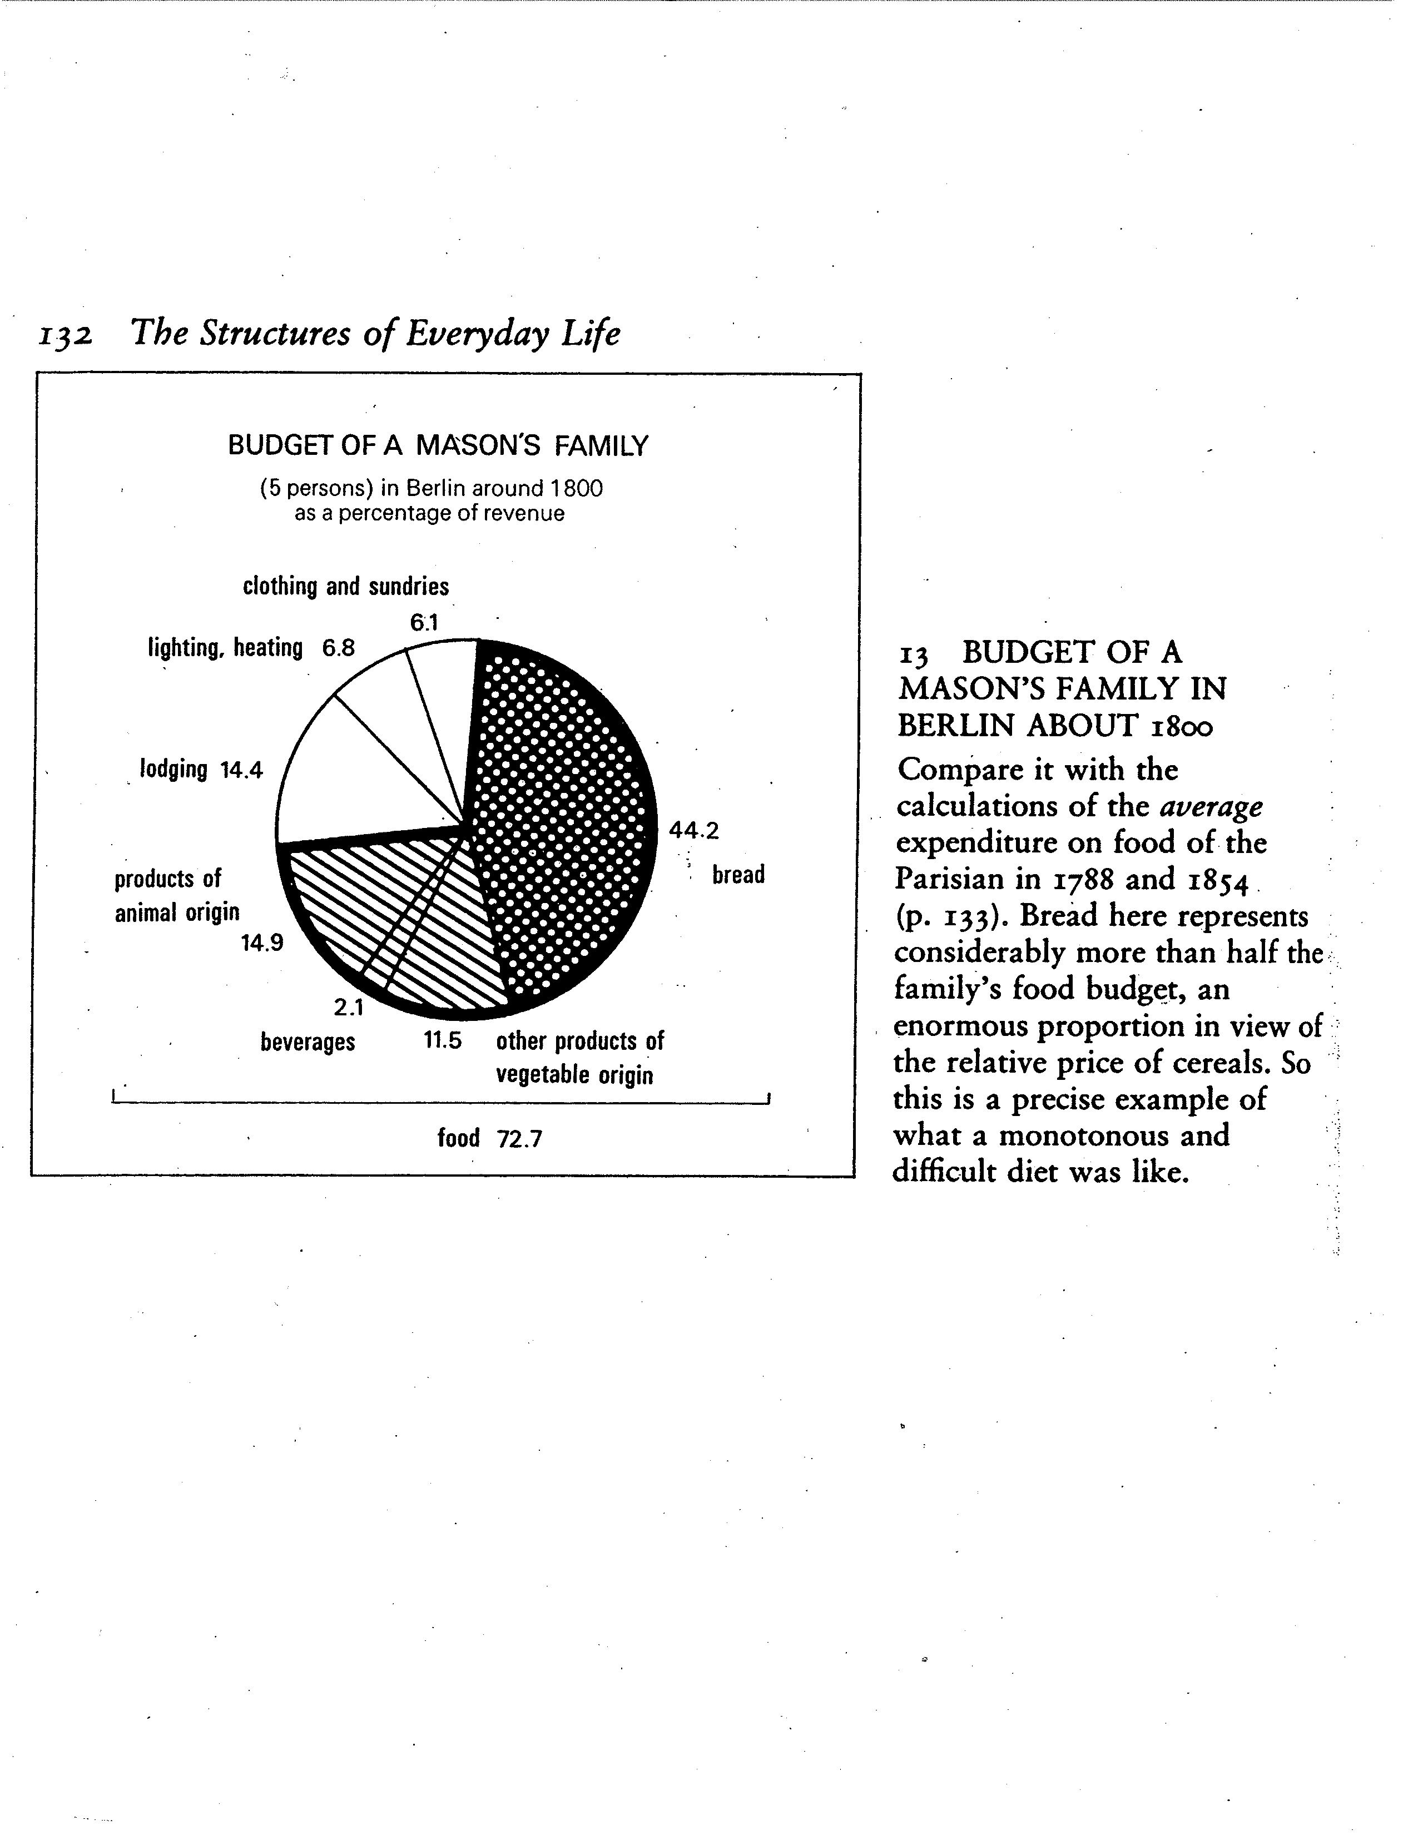
http://www.nytimes.com/interactive/2008/05/03/business/20080403_SPENDING_GRAPHIC.html
Notes:
We just covered what comes out! Let’s see what went in ( for men, not horses!)

Slide 18
Recorded Music
What has been the progression that brought us to the iPod?
Creative Destruction
How long will it take for your iPod to go into your desk drawer to be forgotten?
Notes:
Another favorite example I use in class – music.
Click on the progression link
We are back to Joseph Schumpeter –
Stress the creative in creative destruction

Slide 19
Innovation and Invention
For progress to occur there has to be innovation and invention
There has always been innovation and invention, but the pace has picked up significantly
Most significant profits are made in mass markets
Notes:
The real key is the ability to make a fortune on providing these innovations to the masses
Windows is not necessarily the best operating system but it is the one adopted, for whatever reasons, by the masses
The iPod is an MP3 player and MP3 payers existed on the market for a couple of years before the iPod but Apple popularized it.

Slide 20
Notes:
Patent activity shows a distinct upward trend
What pushes this kind of pattern? Very high growth rates beginning around 1980 due to technology of all sorts – computer and biomedical.
There are many who believe that technology drives this – that there is an inherent trait in man that will come forth without incentives. I reject this – innovation without incentive is like bread without yeast -- it remains flat. The rising of the bread requires a catalyst – yeast. The rising of mass production of consumer goods also requires a catalyst – profits.

Slide 21
And yet,
“The probability of commercial success for inventions developed by independent inventors was determined to be exceptionally low: 6.5% ([+ or -] 0.7%)."
Source: Thomas Astebro, “Basic statistics on the success rate and profits for independent inventors”, Entrepreneurship: Theory and Practice, December 22, 1998.
Notes:
Thus even within the creative destruction or “churn” there is additional churn. The competitive process is one of phenomenally dynamic change. What are the effects of suppressing that dynamic change?

Slide 22
How have we done in America?
Time Series sources for historical perspectives
Moore and Simon
It's Getting Better All the Time: 100 Greatest Trends of the Last 100 year
Cox and Alms at the Dallas Fed
Time Well Spent 1997 Annual Report of the Dallas Fed
All Dallas Fed Annual Reports between 1992 and 1997
Book: Myths Of Rich And Poor: Why We're Better Off Than We Think (2000)
2009 in The American Magazine titled “How are we doing?”
100 Years of U.S. Consumer Spending: Data for the Nation, New York City, and Boston
Bureau of Labor Statistics
Notes:
My first foray into this topic began with this Dallas Fed publication. A great “first read”

Slide 23
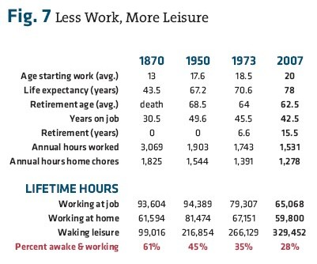
Cox and Alm
Notes:
http://www.american.com/archive/2008/july-august-magazine-contents/how-are-we-doing
How Are We Doing?
By W. Michael Cox and Richard Alm From the July/August 2008 Issue
Filed under: Big Ideas
Accessed 26 Jan 2010

Slide 24
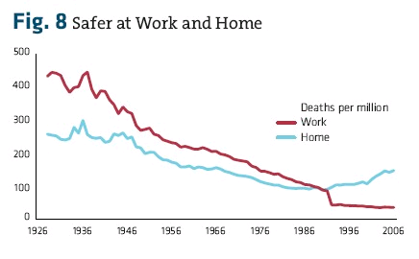
Cox and Alm
Notes:
http://www.american.com/archive/2008/july-august-magazine-contents/how-are-we-doing
How Are We Doing?
By W. Michael Cox and Richard Alm From the July/August 2008 Issue
Filed under: Big Ideas
Accessed 26 Jan 2010

Slide 25
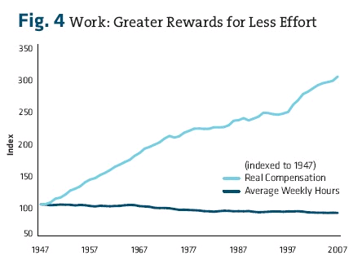
Cox and Alm
Notes:
http://www.american.com/archive/2008/july-august-magazine-contents/how-are-we-doing
How Are We Doing?
By W. Michael Cox and Richard Alm From the July/August 2008 Issue
Filed under: Big Ideas
Accessed 26 Jan 2010

Slide 26
How have we done globally?
Natural Resource Scarcity and Technological Change
Stephen P. A. Brown and Daniel Wolk
Population Growth and Technological Change: One Million B.C. to 1990
Michael Kremer
Notes:
OK – OK: but that’s true for just the rich, industrialized, western world (You know, the imperialists…) you say?!?!?

Slide 27
Norman Borlaug Father of the Green Revolution
Penn & Teller Episode of Bullshit
1970 Nobel Peace Prize
Genetic work in cereals and grains saves hundreds of millions of lives
Currently under attack for genetic engineering by “the human haters”
(i.e., rabid environmentalist groups)
The Norman Borlaug Rap
Notes:
Forgive my sense of humor…

Slide 28
Pinkovskiy, Maxim and Xavier Sala-i-Martin (2009), “Parametric Estimations of the World Distribution of Income”, NBER Working Paper 15433.
World poverty is falling… new estimates of the world’s income distribution… suggest[s] that world poverty is disappearing faster than previously thought. From 1970 to 2006, poverty fell by 86% in South Asia, 73% in Latin America, 39% in the Middle East, and 20% in Africa. Barring a catastrophe, there will never be more than a billion people in poverty in the future history of the world.

Slide 29
Pinkovskiy, Maxim and Xavier Sala-i-Martin (2009), “Parametric Estimations of the World Distribution of Income”, NBER Working Paper 15433.
Although world population has increased by about 80% over this time (World Bank 2009), the number of people below the $1 a day poverty line has shrunk by nearly 64%, from 967 million in 1970 to 350 million in 2006. In the past 36 years, there has never been a moment with more than 1 billion people in poverty, and barring a catastrophe, there will never be such a moment in the future history of the world. Source.
Notes:
Source shows graph.

Slide 30
Take Away – Capitalism
Are capitalists really GRBs?
(“greedy rapacious b#st%rds”)
Or are capitalists and innovators making contributions to human flourishing that reach far beyond thenselves?
“They place their faith in the legislature, I place mine in mankind.”
Frederic Bastiat
Notes:
What is our real experience with capitalism as opposed to central planning?
Is capitalism under-estimated in its contributions to progress by many measures?
What is it so important to attack capitalism and money as the root of all evil?
In whose interest is this attack?
Why is it so easy for most people to accept?

Slide 31
No, Chicken Little, the Sky is Not Falling!
Pre-eminent philosophers of the 20th century

