Slide 1
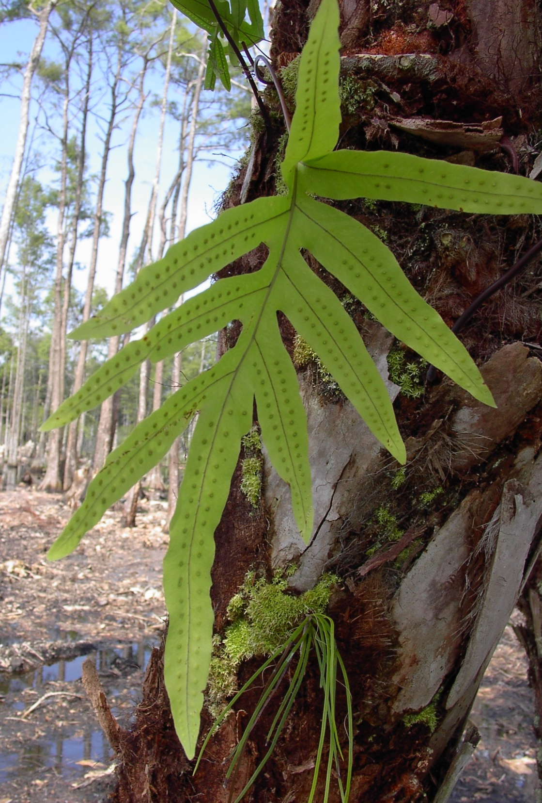
Florida Forever
Land Acquisition
Heather Stafford
heather.stafford@dep.state.fl.us
Estero Bay Aquatic Preserve
700-1 Fisherman’s Wharf
Fort Myers Beach, Fl 33931
239-463-3240
Charlotte Harbor Aquatic Preserves
12301 Burnt Store Road
Punta Gorda, Fl 33955
941-575-5861 ext 106

Slide 2
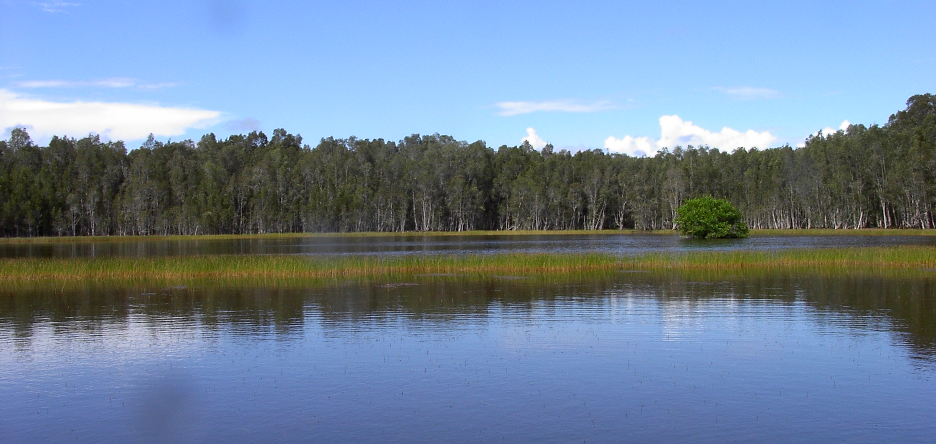
The draining of the Everglades in the 1930s began an era of rampant growth in Florida. Since the 1950s, Florida’s population has risen at an annual rate of approximately four percent. In the last 50 years, more than eight million acres of forest and wetland habitats (about 24 percent of the state) have been developed.

Slide 3
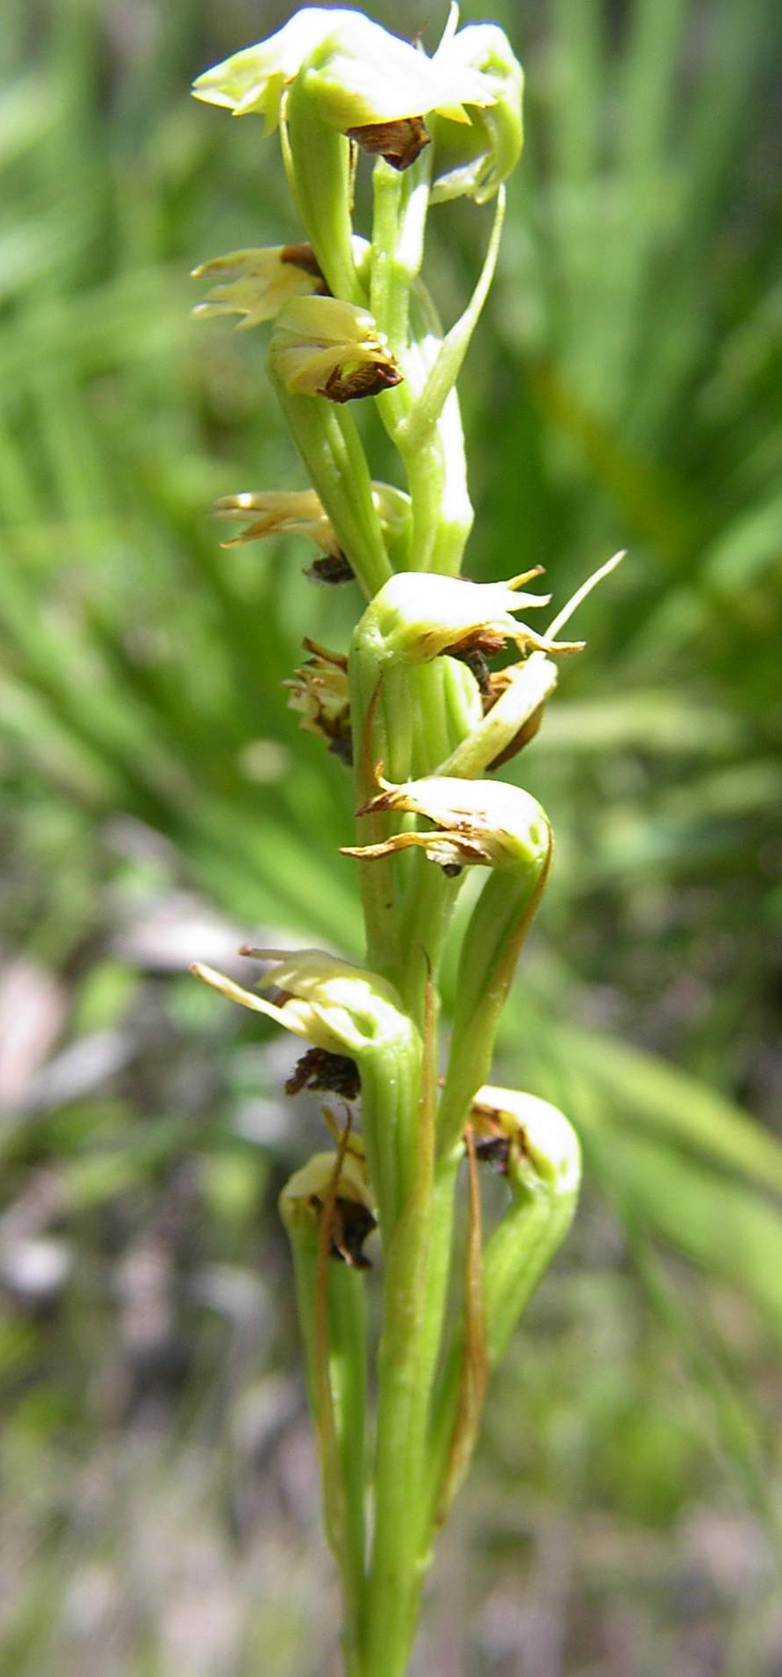
History of Florida's
Conservation Efforts
Florida has a long tradition of conservation. It is the site of the nation’s first wildlife refuge, Pelican Island, and the first eastern national forest, Ocala National Forest. Over the years the state has implemented several substantial land acquisition programs to save native landscape from development.

Slide 4
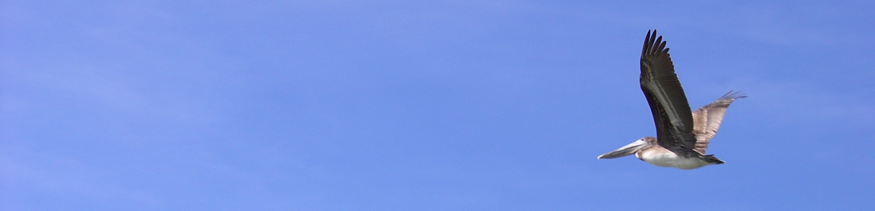
1964: Established a $20 million bond program to acquire outdoor recreational lands.
1972: Allocated an additional $40 million for an outdoor recreation bond and established a $200 million. Environmentally Endangered Lands (EEL) program.
1979: Established the Conservation and Recreation Lands (CARL) Program.
1981: Developed Save Our Coast (SOC) and Save Our Rivers (SOR) programs.
1990: Established the Florida Preservation 2000 program.
2000: Started the Florida Forever program.

Slide 5
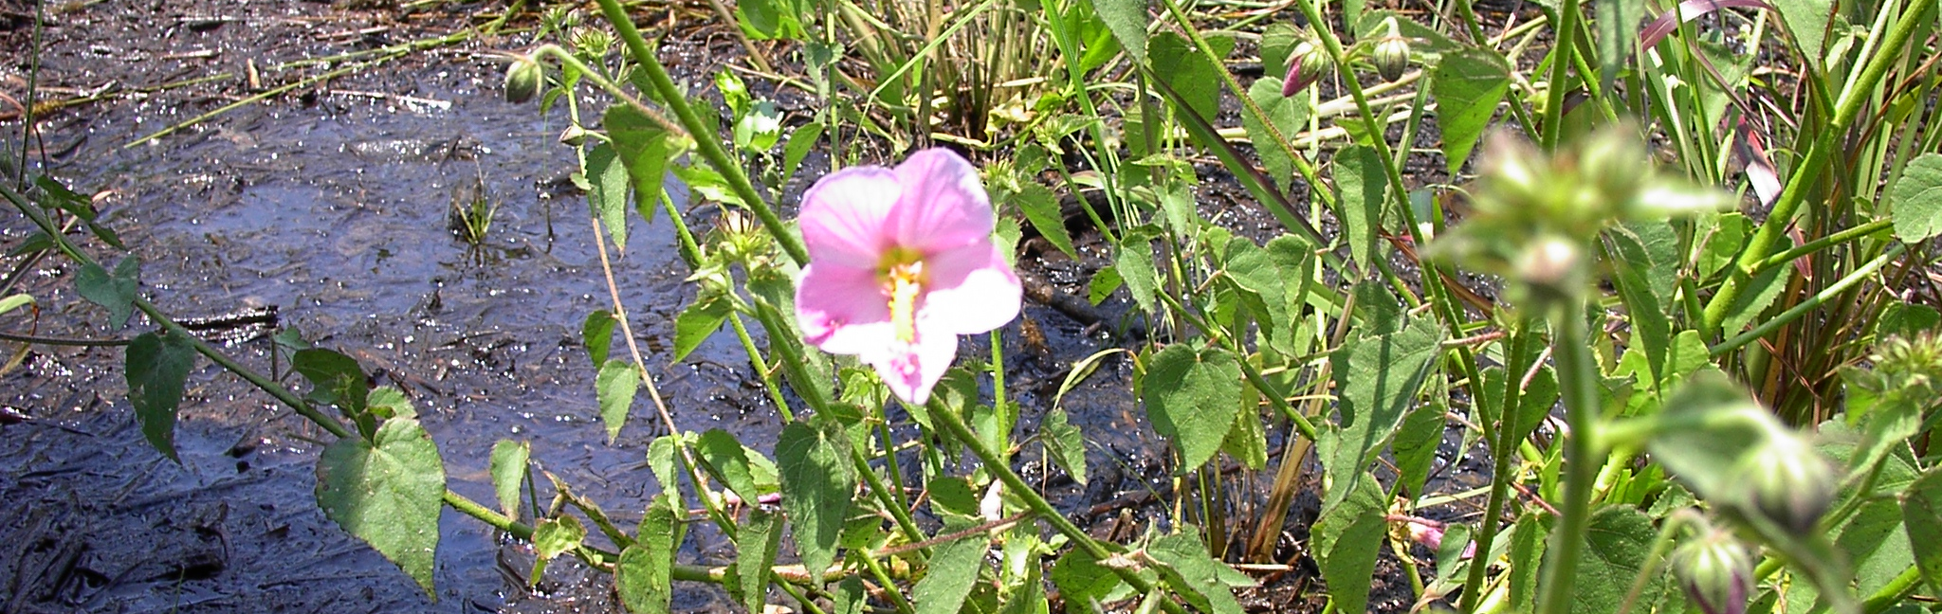
Florida Forever replaced Preservation 2000 (P2000), the largest public land acquisition program of its kind in the United States. With a total of 3.8 million acres of conservation land in Florida, 2.4 million acres were purchased under the Florida Forever and P2000 programs.
Between its inception in July 2001 and June 2008, the Florida Forever program has acquired more than 621,200 acres of land with $2.39 billion.

Slide 6
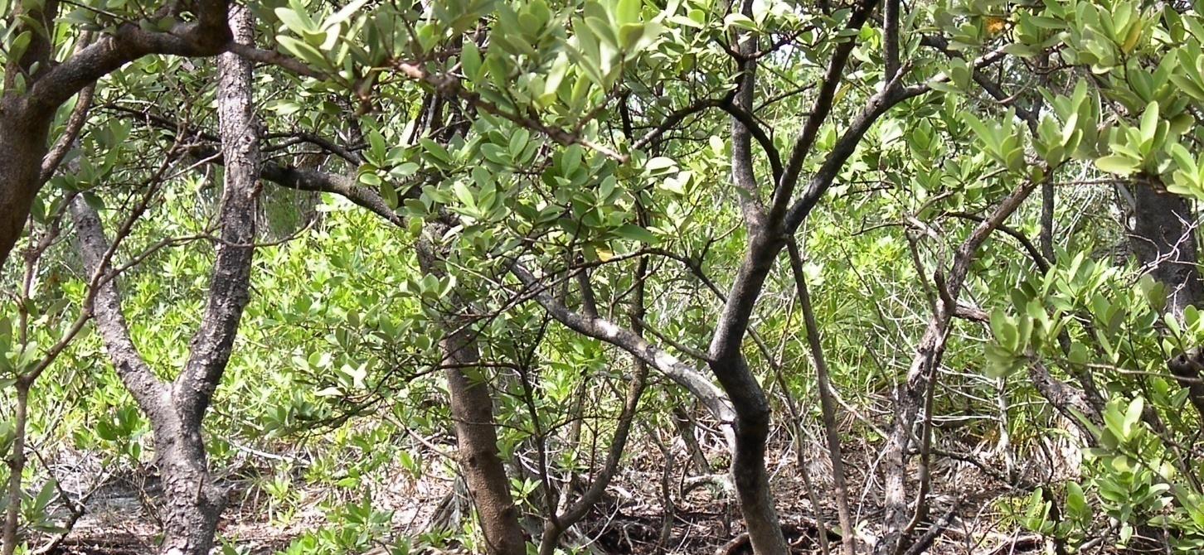
DEP’s Division of State Lands provides oversight for more than 11 million acres of state lands, including lakes, rivers and islands. Of these, 3.8 million acres are conservation lands that are protected for citizens, visitors and future generations. These lands cleanse and restore the waters we drink and the air we breathe, and provide a home to tens of thousands of rare and endangered animals.

Slide 7
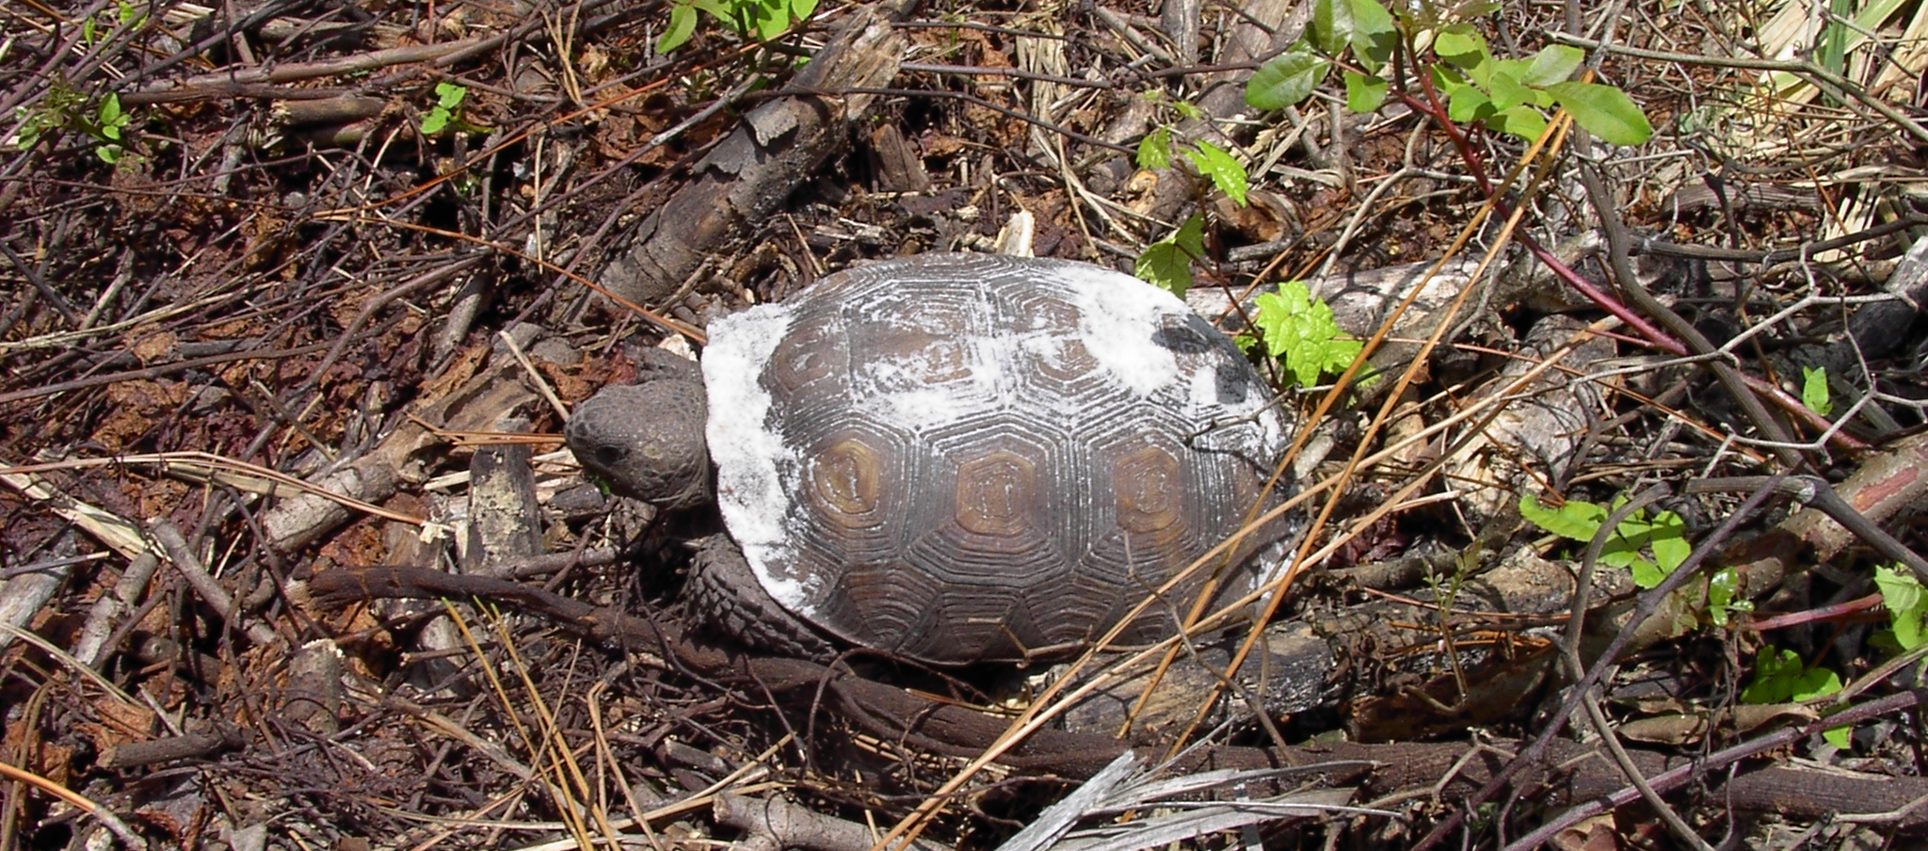
Florida Forever has conserved habitats for 175 protected species (96 state-listed as endangered, 37 state-listed as threatened and 16 species of special concern).

Slide 8
Land Acquisition as of August 31, 2008
 | P2000 |  | Florida Forever
Fiscal Year | Acres | Expenditures | Acres | Expenditures
Through June 30, 1999 | 1,128,221 | $1,931,196,210 | - | -
1999 - 2000 | 178,051 | $367,102,902 | - | -
2000 - 2001 | 212,233 | $406,438,299 | - | -
2001 - 2002 | 172,075 | $215,063,001 | 95,202 | $150,111,950
2002 - 2003 | 56,211 | $55,043,776 | 128,251 | $340,309,078
2003 - 2004 | 34,777 | $274,097,717 | 68,811 | $210,289,513
2004 - 2005 | (79) | $37,619,402 | 105,561 | $303,749,575
2005 - 2006 |  |  | 54,138 | $329,113,999
2006 - 2007 |  |  | 100,801 | $671,586,763
2007-2008 |  |  | 68,462 | $384,566,316
 |  |  | 217 | $48,629,341
TOTAL | 1,781,489 | $3,286,561,308 | 621,444 | $2,489,356,534
Notes:
Note: The Expenditure amount for 2003-2004 includes the $200,000,000 transferred to the Save Our Everglades Trust Fund from Surety Bond Proceeds GAA 31 & 32 and the Expenditures to date for the Florida Forever 4th Series Appropriation GAA 1518A
The negative acres amount for 2004-2005 is a result of the final reconciliation of acres.
Totals may not be exact due to rounding.

Slide 9
Conservation Easements as of August 31, 2008
 | P2000 |  | Florida Forever
Fiscal Year | Acres | Expenditures | Acres | Expenditures
Through June 30, 1999 | 107,466 | $38,550,612 | - | -
1999 - 2000 | 54,412 | $49,006,520 | - | -
2000 - 2001 | 64,157 | $51,432,333 | - | -
2001 - 2002 | 31,180 | $19,192,973 | 14,038 | $6,348,424
2002 - 2003 | 3,510 | $1,456,421 | 26,643 | $20,242,610
2003 - 2004 | 4,529 | $16,047,551 | 15,259 | $11,219,242
2004 - 2005 |  |  | 43,302 | $44,352,702
2005 - 2006 |  |  | 12,176 | $9,450,584
2006 - 2007 |  |  | 1,715 | $12,305,930
2007 - 2008 |  |  | 13,142 | $38,338,254
2008 - 2009 |  |  | 663 | $818,730
TOTAL | 265,255 | $175,686,409 | 126,937 | $143,076,474
Save Our Everglades Trust Fund Land Acquisition (as of November 17, 2008)
Fiscal Year | Acres | Expenditures
2000-2008 | 65,891 | $818,370,933

Slide 10
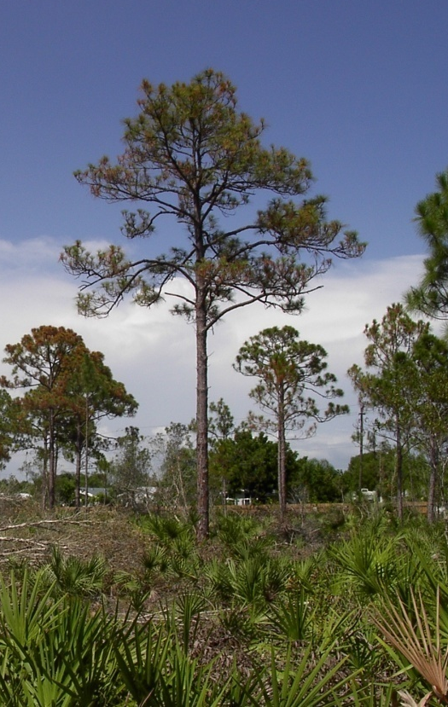
The Future
of Florida Forever
Governor Charlie Crist and the Florida Legislature extended Florida Forever for another ten years, through 2020, at the same funding level.
Notes:
Although the program remains fundamentally unchanged, the legislature added several more reporting requirements, provided for more prioritization of projects within several categories and provided for spending Florida Forever funds on capital improvements on state-owned conservation lands.

Slide 11
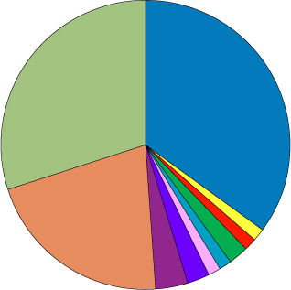
Florida Forever Funding
Distribution - June 2008
Florida Forever funding is allocated by the legislature at $300 million per year.
Division of State Lands - $105 million
Division of Recreation and Parks - $4.5 million
Office of Greenways and Trails - Rails to Trails - $4.5 million
Florida Recreation Development Assistance Program (FRDAP) - $6 million
Florida Fish and Wildlife Conservation Commission - $4.5 million
Division of Forestry, DACS - $4.5 million
Rural & Family Lands, DACS - $10.5 million
Stan Mayfield Working Waterfront, DCA, $7.5 million
Florida Communities Trust, DCA - $63 million
Water Management Districts - $90 million
Notes:
Florida Forever Funding Distribution - June 2008
Florida Forever funding is allocated by the legislature at $300 million per year. It is distributed by the Florida Department of Environmental Protection to a number of state agencies and programs to purchase public lands in the form of parks, trails, forests, wildlife management areas and more. All of these lands are held in trust for the citizens of Florida.

Slide 12
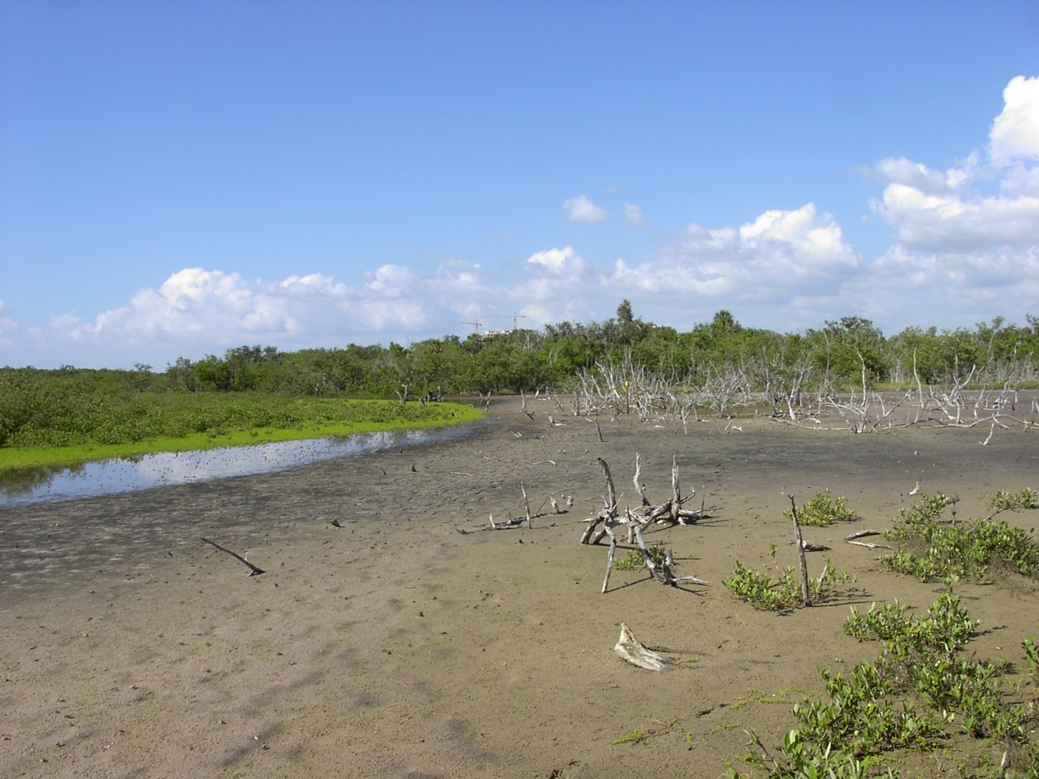
Florida Forever Goals
coordination & completion of projects
protection of Florida’s biodiversity
protect, restore & maintain natural functions
sufficient quantities of water (current & future)
recreational & educational opportunities
archaeological & historic sites
forest land for sustainable management
urban open space

Slide 13
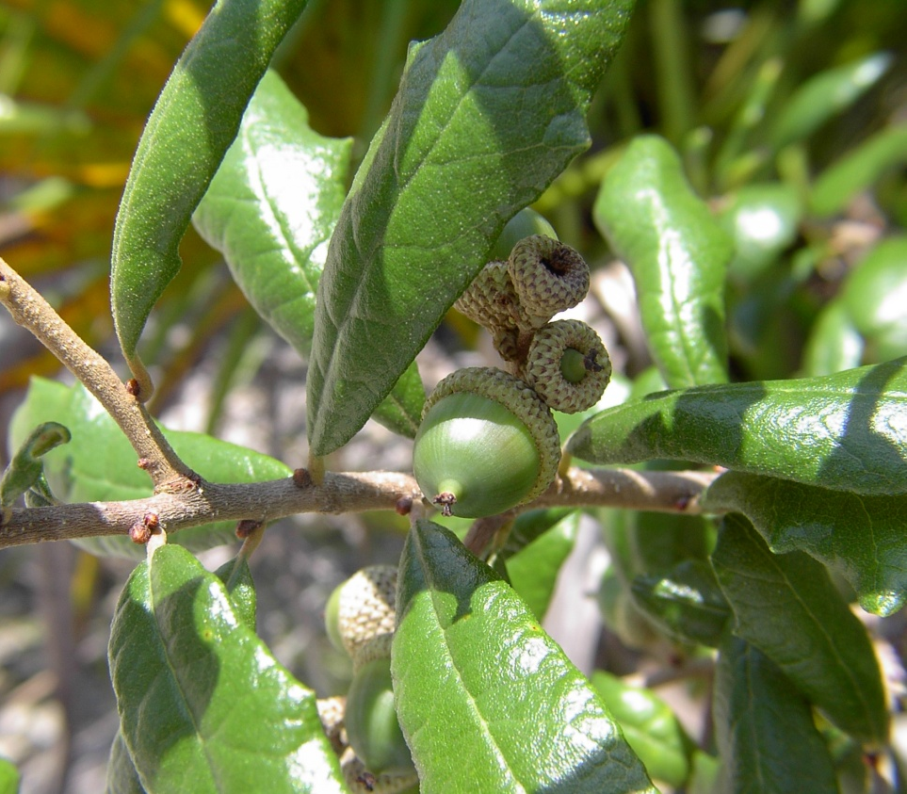
Florida Forever Measures
34 performance measures under 8 goals
  3 → acquisition coordination & completion
  6 → biodiversity
  11→ restoration & protection of ecosystems
  3 → quantities of water
  3 → public recreation
  2 → archaeological & historical
  4 → sustainable forestry
  2 → urban open space

Slide 14
Progress - Board of Trustees acquisitions
Resource Category | BOT Progress | Comments
Species | Fair | Insufficient progress on highest priority species habitat; good progress on red-cockaded woodpecker and black bear.
Natural Communities | Poor | With the exception of pine flatwoods and sandhill, very little progress protecting the state's under represented natural communities.
Landscapes | Fair | Measure modified to reflect partial progress toward completing landscape connectors; acquisition of large landscapes has exceeded benchmark.
Watersheds | VeryGood | Very good progress protecting surface waters and floodplains, including springs.
Wetlands | Very Good | Very good progress protecting all priorities of wetlands.
Forestry | Very Good | Acquisition of forestry resources has greatly exceeded benchmark.
Notes:
Board of Trustees acquisitions have achieved substantial conservation progress across several natural resource categories, while some resources have seen little progress.
~Draft 2008 Florida Forever Bench Mark Report

Slide 15
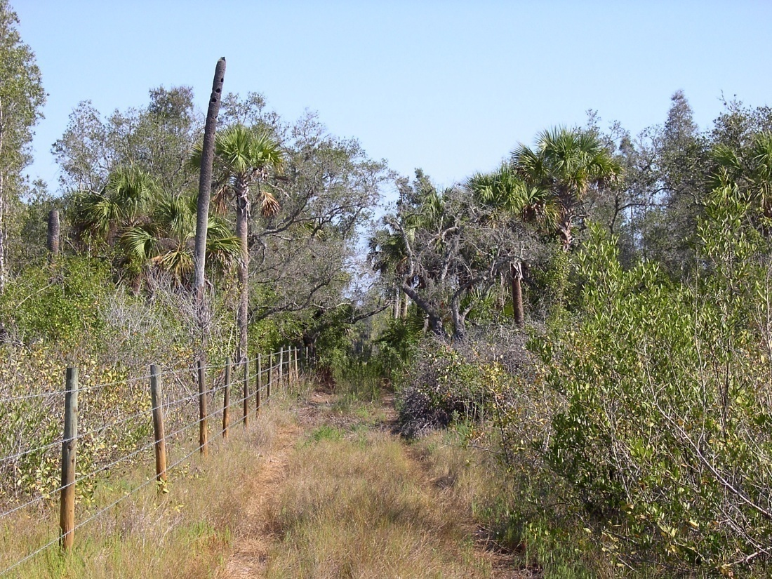
Acquisition and Restoration Council
The Acquisition and Restoration Council membership is established by law [§259.035(1), Florida Statutes] and consists of the:
Secretary, Department of Environmental Protection
Director, Division of Forestry, Department of Agriculture and Consumer Services
Executive Director, Florida Fish and Wildlife Conservation Commission
Director, Division of Historical Resources, Department of State
Secretary, Department of Community Affairs
Four Governor Appointees from scientific disciplines related to land, water, or environmental sciences
Notes:
The Acquisition and Restoration Council (ARC) replaced the Land Acquisition and Management Advisory Council (LAMAC). The Council has sole responsibility for the evaluation, selection and ranking of state land acquisition projects on the Florida Forever priority list. The Council, with the assistance of staff and the Florida Natural Areas Inventory (FNAI), annually reviews all Florida Forever acquisition proposals, decides which proposals should receive further evaluation through the preparation of detailed resource assessments, determines the final project boundaries and establishes the priority ranking of Florida Forever projects.
ARC is also responsible for reviewing land management plans prepared by state agencies, local governments and others who manage the state's conservation lands. ARC also reviews land use requests that affect the state's conservation lands, including utility and access easements, subleases and others.
The FNAI provides scientific support to the Florida Department of Environmental Protection (DEP) and the Council for Florida Forever, the nation's largest environmental land acquisition program. The Inventory contributes in two key ways: scientific review of newly proposed land acquisition projects, and comprehensive natural resource analysis and scoring of all Florida Forever projects using the Conservation Needs Assessment and F-TRAC.

Slide 16
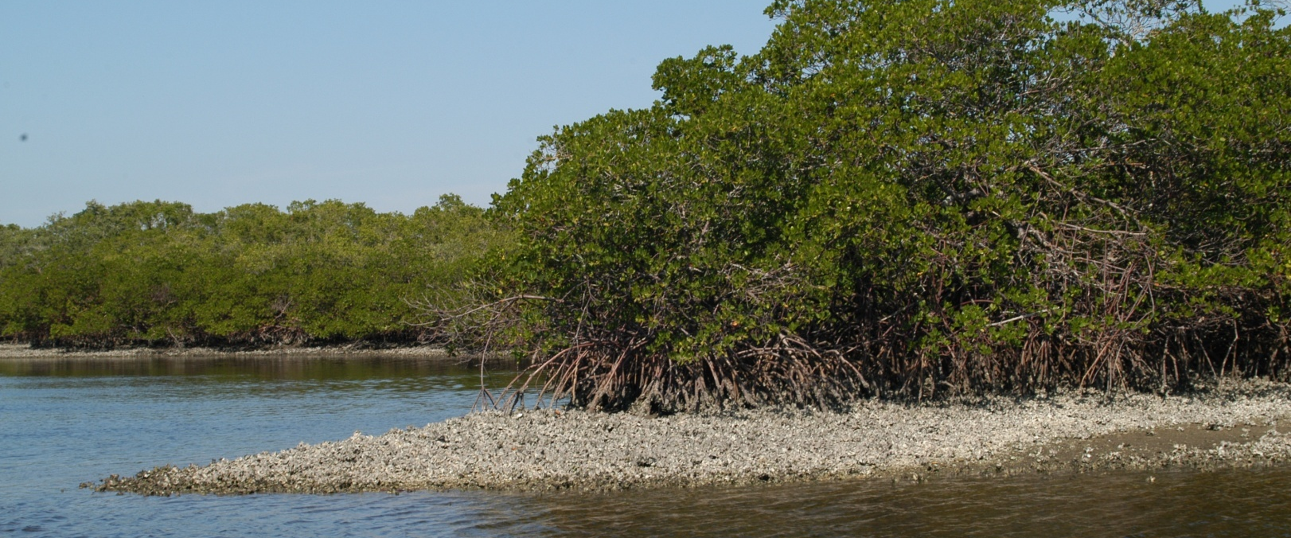
Priority Projects
September 2008
The Acquisition & Restoration Council’s September 2008 Florida Forever Priority List contains 107 projects
of which 21 are listed as highest acquisition priority.

Slide 17
Project Name | County
Adams Ranch (LTF) | Osceola
Apalachicola River (FF/LTF) | Jackson / Gadsden / Liberty / Calhoun
Bombing Range Ridge (FF / LTF) | Polk / Highlands / Osceola
Caber Coastal Connector (FF) | Levy
Clear Creek / Whiting Field (FF) | Santa Rosa
Corkscrew Reg Ecosystem Watershed (FF/LTF) | Lee / Collier
Escribano Point (FF) | Santa Rosa
Estero Bay (FF) | Lee
Florida Keys Ecosystem (FF) | Monroe
Florida’s First Magnitude Springs (FF) | Walton/ Washington/ Bay/ Jackson/ Wakulla/ Leon/ Hamilton/ Madison/ Suwannee/ Lafayette/ Levy/ Marion/ Hernando/
Indian River Lagoon Blueway (FF) | Volusia / Brevard / Indian River / St. Lucie / Martin
Lake Wales Ridge Ecosystem (FF/ LTF/ SH) | Lake / Osceola / Polk / Highlands
Myakka Ranchlands (FF / LTF) | Sarasota
Northeast Florida Blueway (FF) | Duval / St Johns / Flagler
Northeast Florida Timberlands and Watershed Reserve (FF / LTF) | Duval / Nassau / Clay
Ochlockonee River Conservation Area (LTF) | Gadsden / Leon
St. Joe Timberland (FF) Washington | Bay / Franklin / Gadsden / Gulf / Jef-ferson / Leon / Liberty / Taylor / Wakulla/ Walton /
St. Johns River Blueway (FF/LTF) | St. Johns
Upper St. Marks River Corridor (FF) | Leon / Jefferson / Wakulla
Wakulla Springs Protection Zone (FF) | Wakulla / Leon
Wekiva-Ocala Greenway (FF/LTF) | Lake / Orange / Seminole / Volusia
Notes:
(FF): Full-Fee: projects proposed to be purchased in Fee Simple. (LTF): Less-Than-Fee: property stays with the owner, but conservation easements or other means preserve the environmental value of the land. (SH): Small Holdings: projects made of small ownerships with individual values generally not exceeding $1,000,000.
Table adapted from Draft Benchmark report.

Slide 18
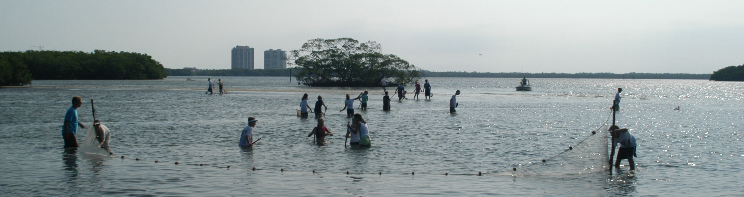
Estero Bay Ranking History
Project Name | 1998 | 1999 | 2000 | 2001 | 2002 | 2003 | 2004 | 2005 | 2006 | 2007 | 2008
Estero Bay | 11P | 9P | 8P | BF | AF | AF | AF | BF | AF | AF | AF
Projects ranked in one or more of six groups in 1986-2000: |  |  | Projects are ranked in the following Groups in 2001-2005:
P = Priority | S = Substantially Complete |  | AF / BF = Full Fee project in “A” or “B” group
B = Bargain / Shared | L = Less-Than-Fee |  | AL / BL = Less-Than-Fee project in “A” or “B” group
M = Mega / Multiparcel | N = Negotiation Impasse |  | ASm / BSm = Small Parcels project in “A” or “B” group
Notes:
* Notes: (1) Ranking is based on Council annual voting @ December, interim vote not included.
(2) Projects 90% or more complete qualify for continued funding pursuant to Section 259.032(8), F.S.
Estero Bay project is a partnership between TNC, CAMA, USFWS
* Partnership: An entity providing funds for purchase or signifi cant staff contribution to
assist in the purchase; for example, a non-profi t preparing the application, as a minimum.

Slide 19
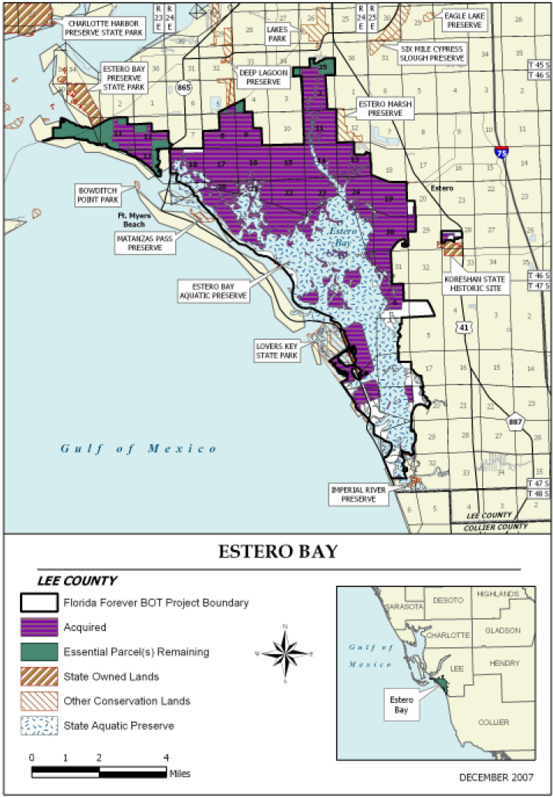
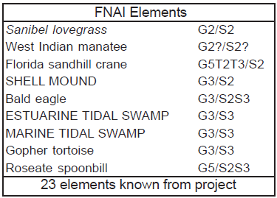
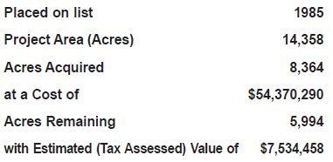

Slide 20
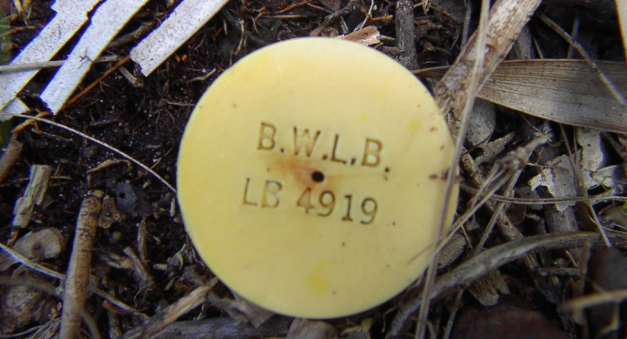
Land Acquisition Process
An individual wishing to sell land to the State of Florida should work with DEP’s Division of State Lands’ Bureau of Land Acquisition.
The Negotiations Section organizes each acquisition, which requires the following:
Appraisal Map: completed through the Bureau of Survey and Mapping;
Appraisal Report: completed through the Bureau of Appraisal;
Negotiate Offer and Contract Terms: based on appraised value of highest and best use of the property. Conservation easements and other less-than-fee transactions may take longer to negotiate terms of easement/contract; and
Board of Trustees' Approval: six-week process, approximately.
http://www.dep.state.fl.us/lands/acquisition/process.htm
Notes:
The Negotiations Section within the Division of State Lands, land acquisition agents negotiate full fee acquisitions, conservation easements and other less-than-fee transactions. This section of the Division also assists with acquisition of projects for the Office of Coastal and Aquatic Managed Areas, Division of Recreation and Parks, Office of Greenways & Trails, Florida Fish and Wildlife Conservation Commission, Florida Division of Forestry and other non-conservation entities such as state universities and the Florida Department of Corrections.
The Closing Section within the Division prepares the transaction for conveyance to State ownership. The agents utilize contractors to perform most aspects of the closing process, such as title searches, closing services and environmental site assessments. The statewide contracts for these services are managed with the Division's Bureau of Land Acquisition Closing Section for accuracy and compliance with the Florida Statutes and DEP policies and procedures.

Slide 21
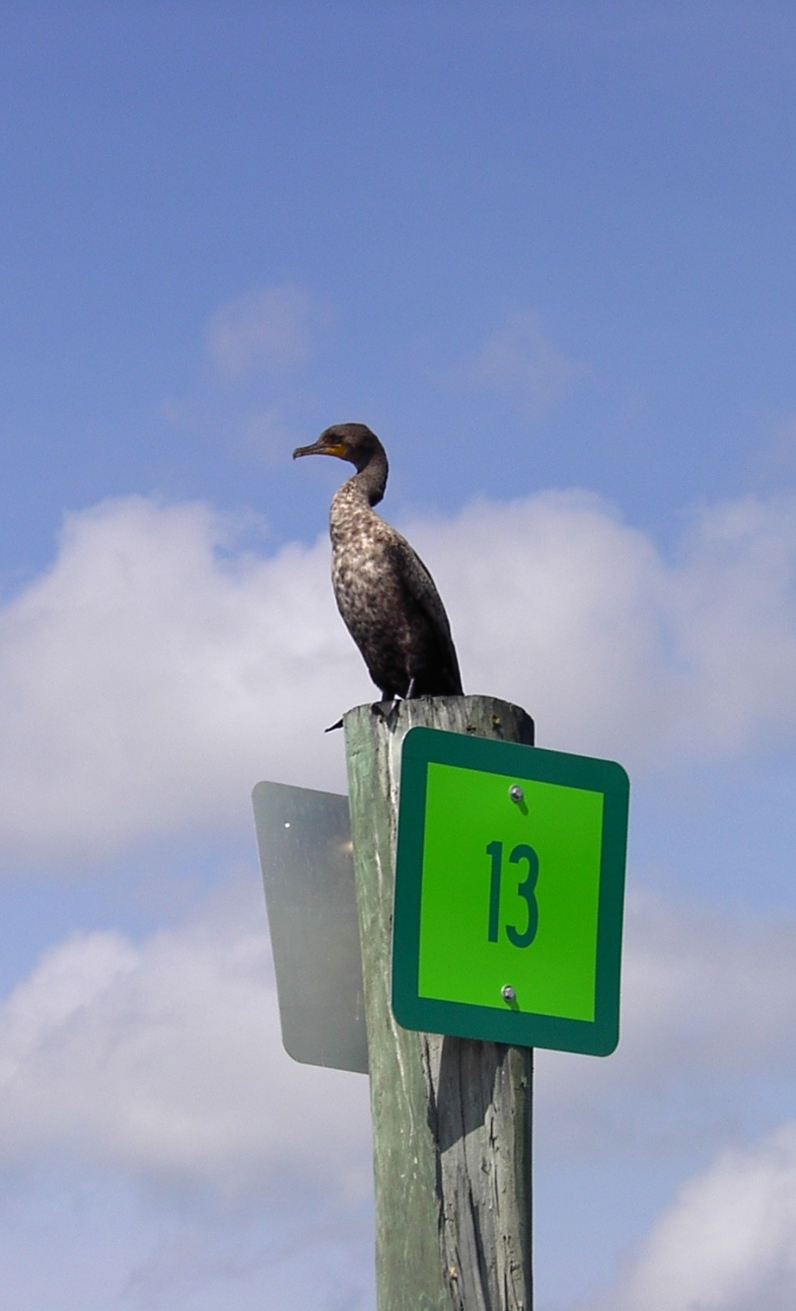
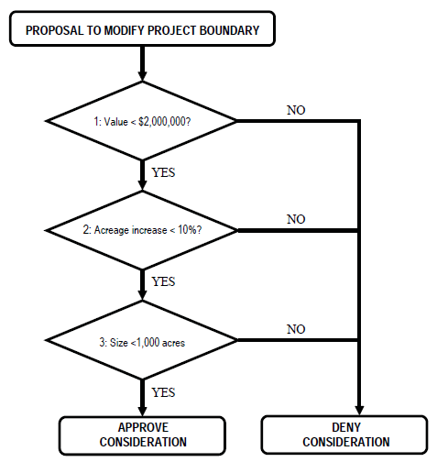
Boundary Expansion

Slide 22
At the start of Florida Forever in 2001, 25% of the state’s 34.7 million acres was managed for conservation. As of Spring 2008, 28% of the state’s lands are managed for conservation.
Managing Agency | Baseline 2001 | Spring 2008
 | acres
Federal (USFS, NPS, USFWS, etc. | 4,031,958 | 4,026,748
State - DEP, DOF, FWC (BOT) | 2,849,380 | 3,386,963
State - Water Management Districts | 1,318,087 | 1,777,634
State - (university reserves, Dept. Of Mil. Affairs, etc.) | 84,040 | 105,157
Local (cities & counties) | 286,804 | 408,197
Private (TNC, Audubon, etc.) | 142,713 | 175,661
Total | 8,712,982 | 9,880,360

Slide 23
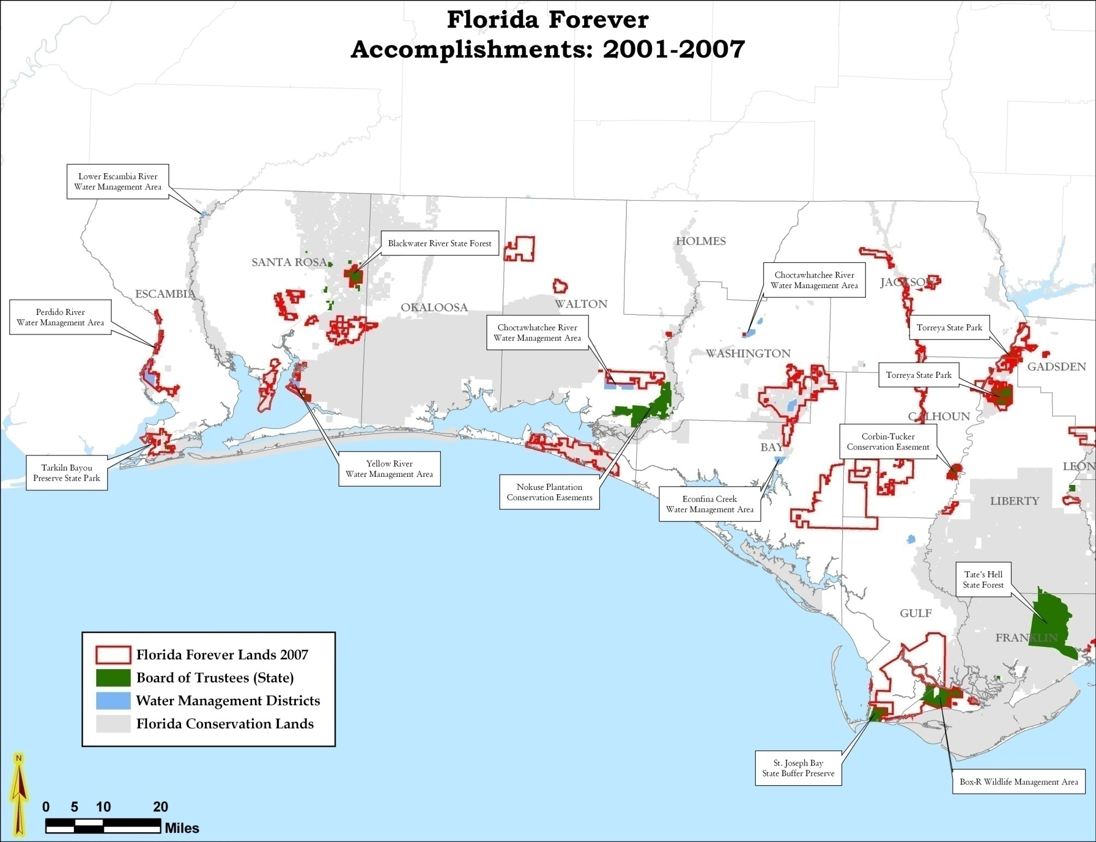

Slide 24
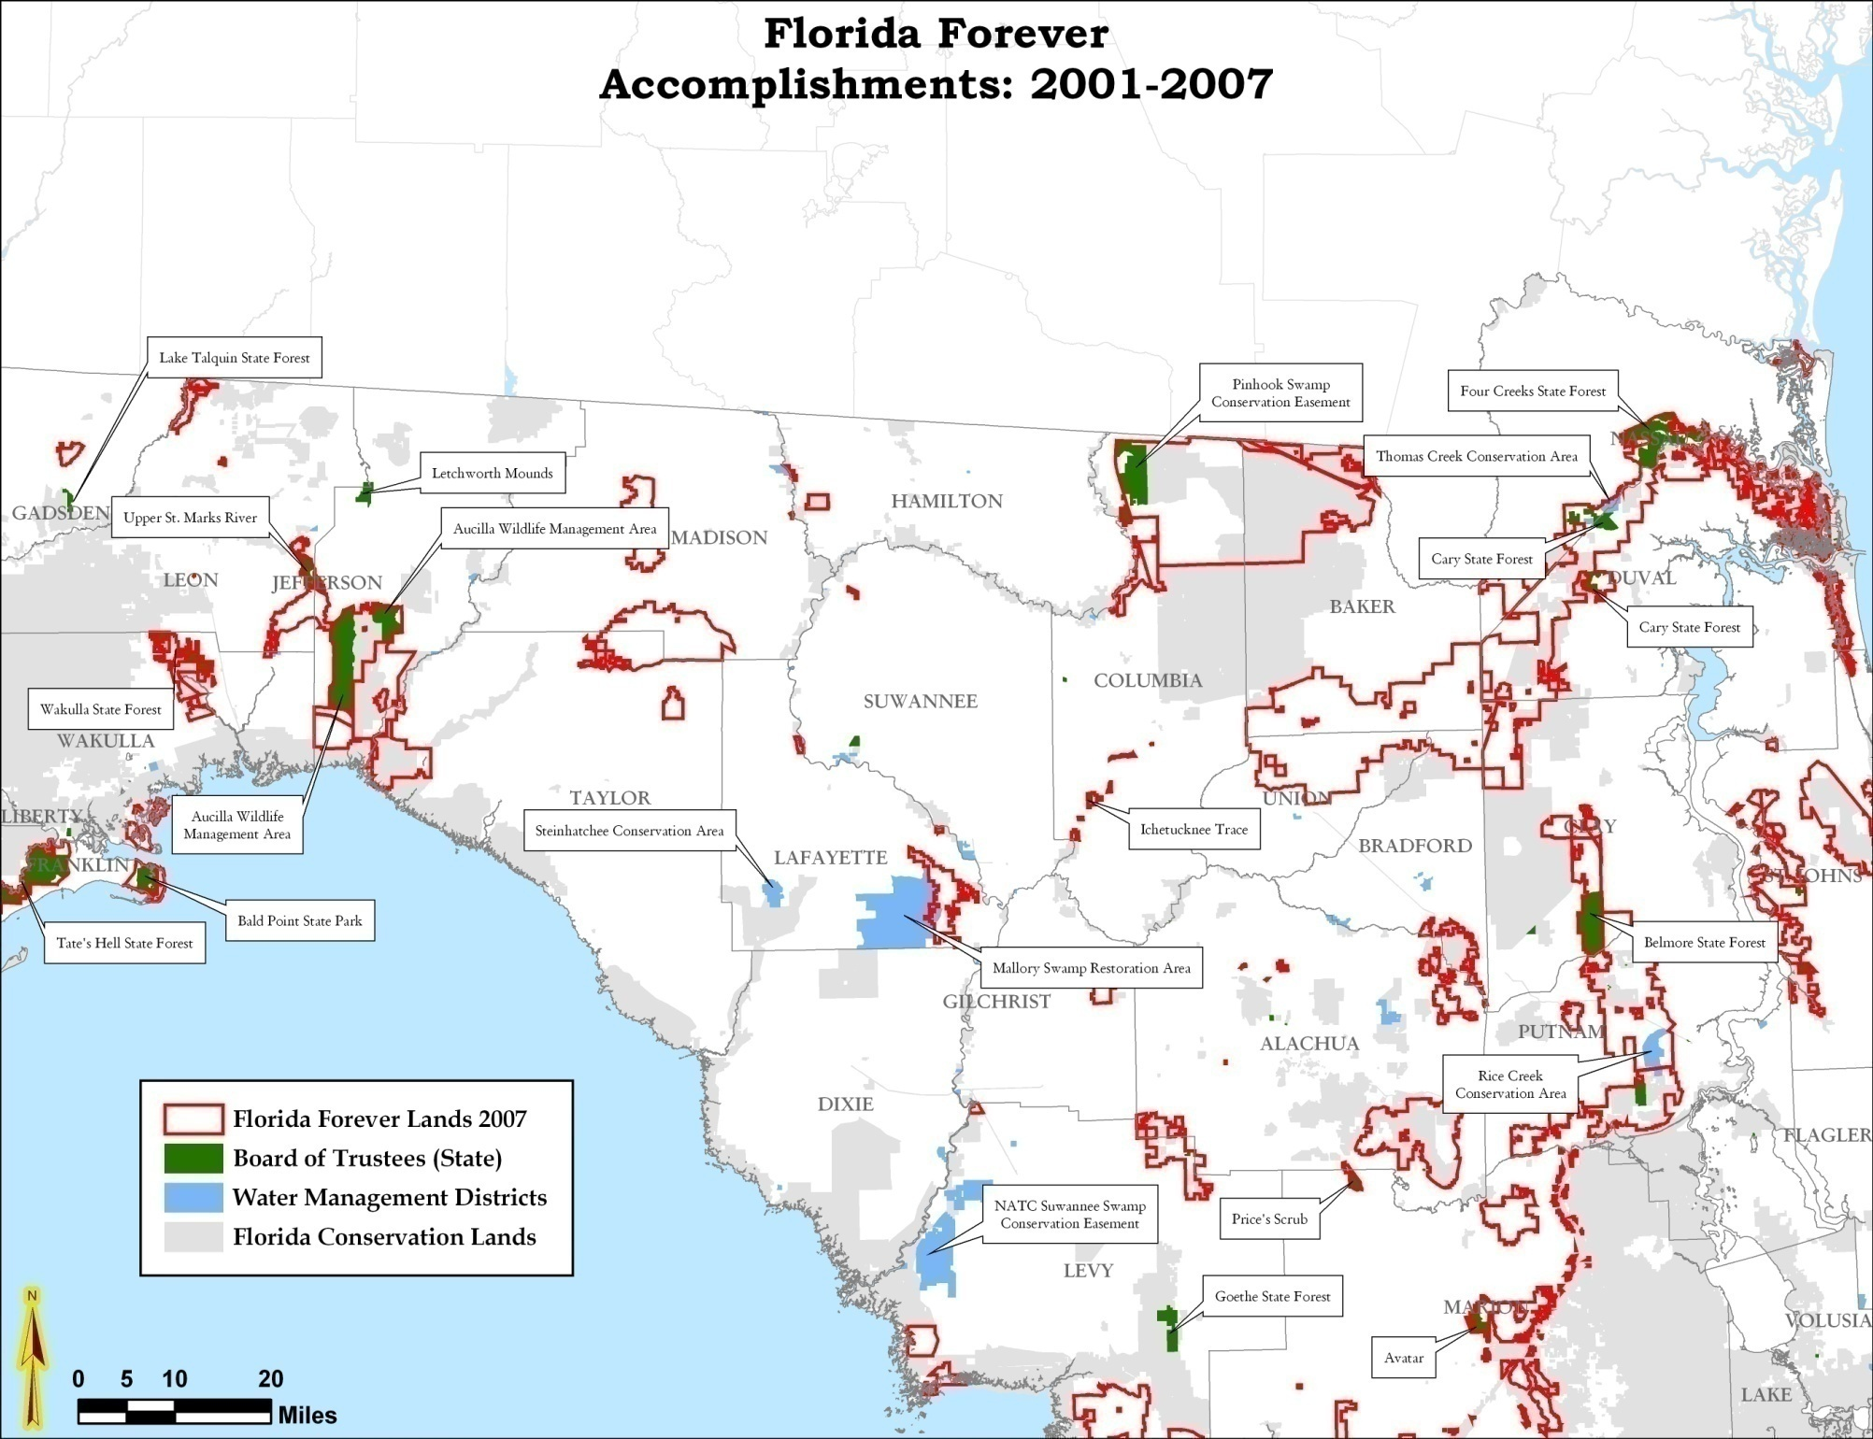

Slide 25
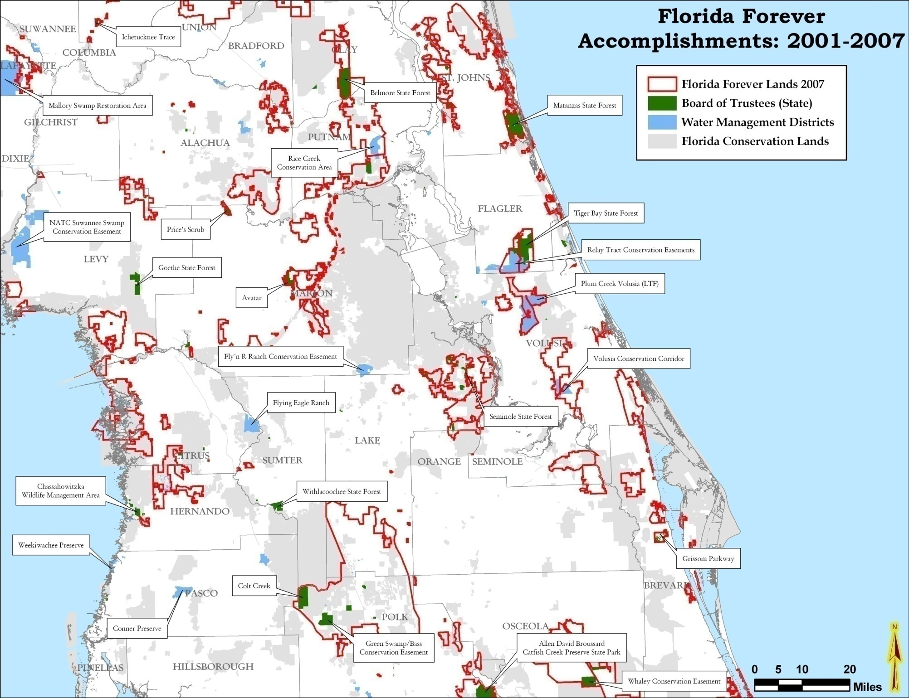

Slide 26
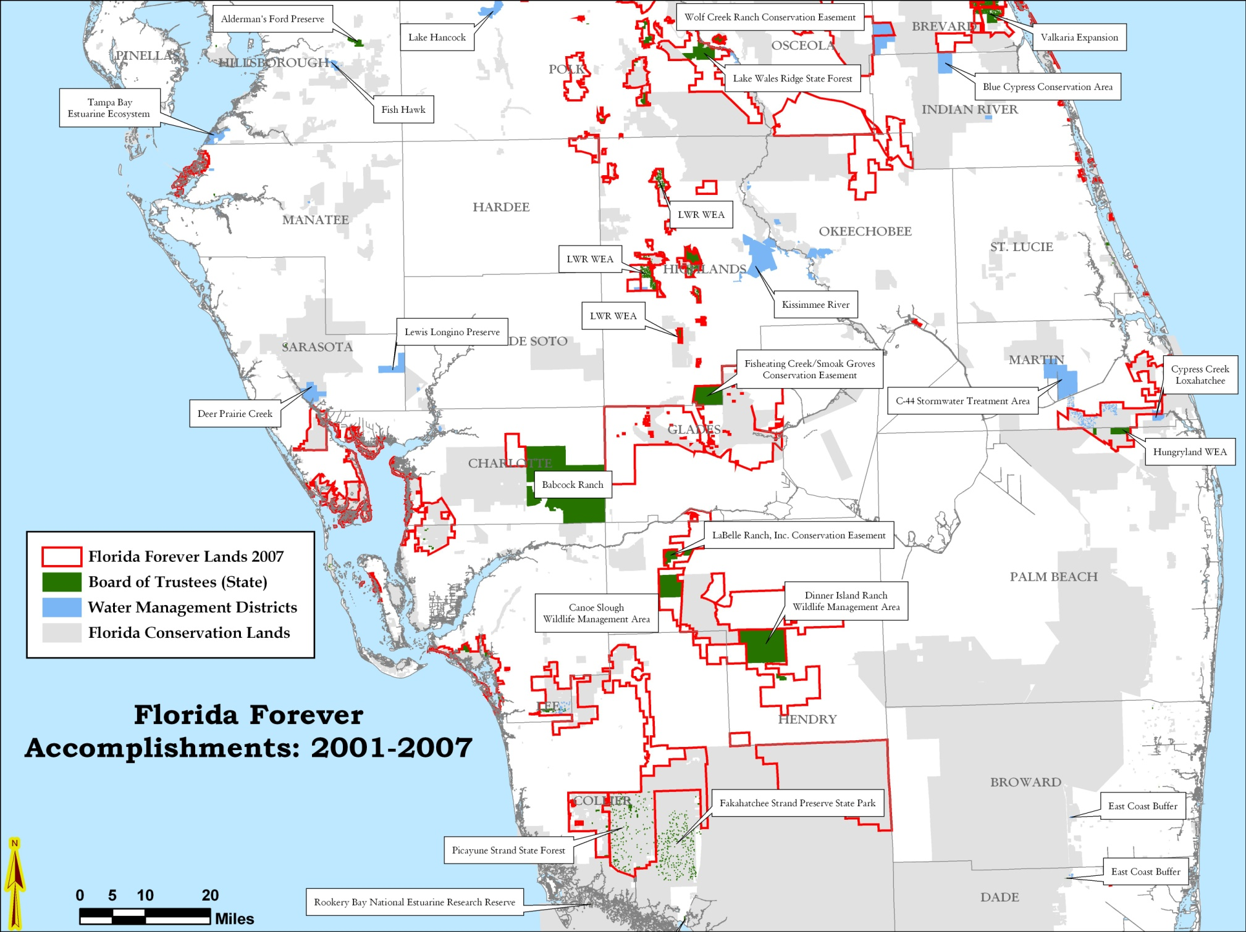

Slide 27
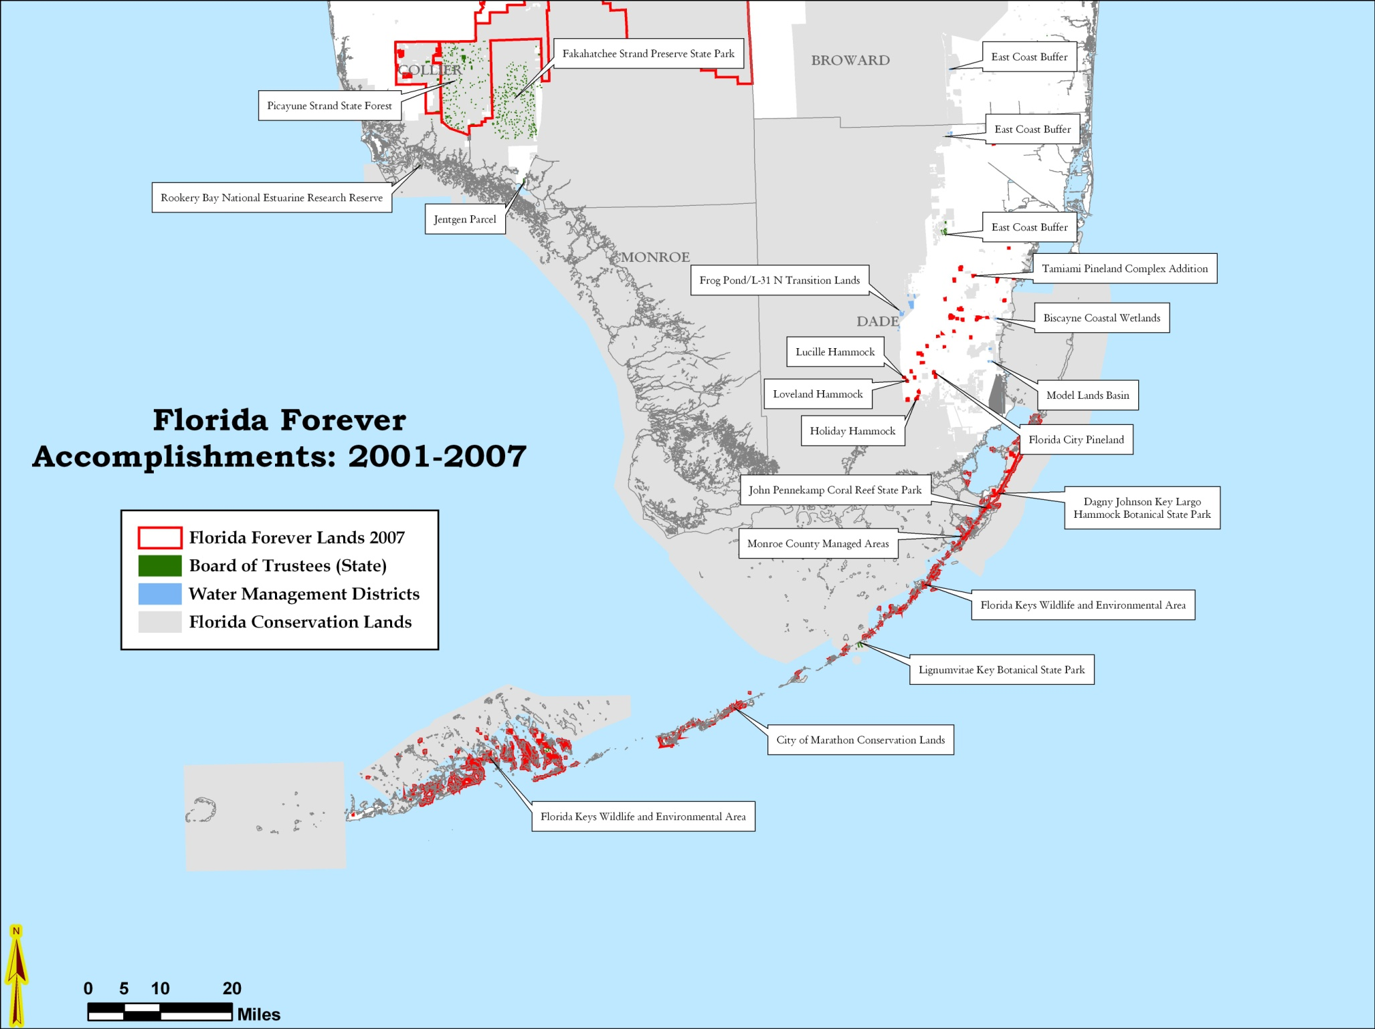

Slide 28
