Slide 1
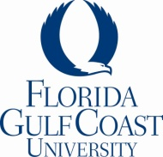
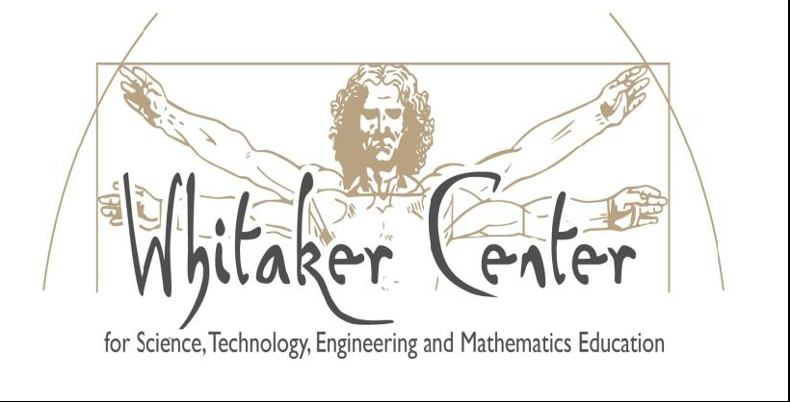
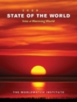
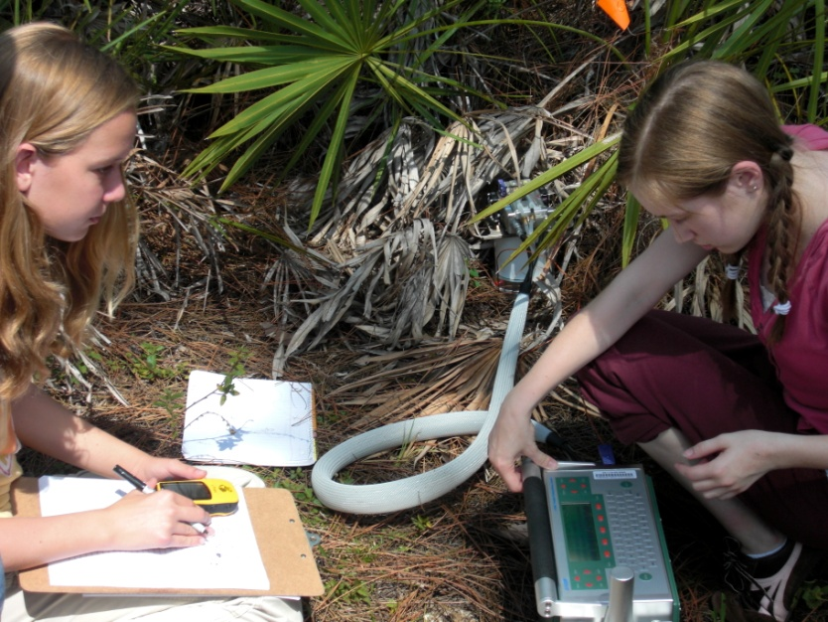
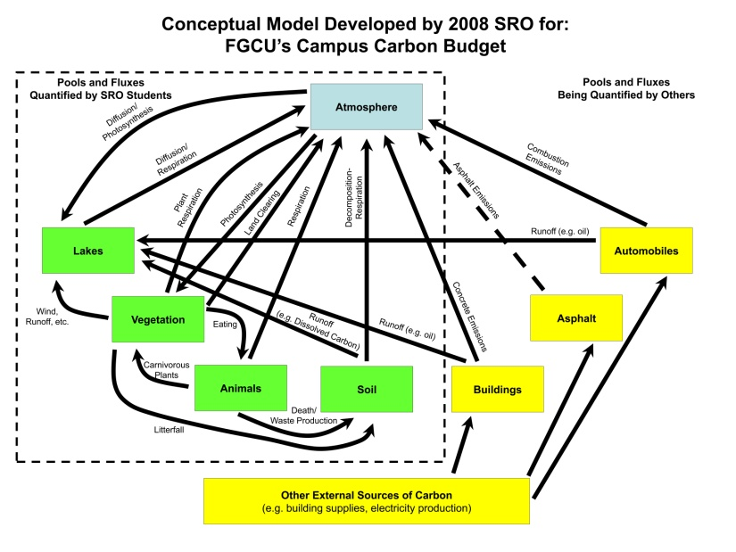
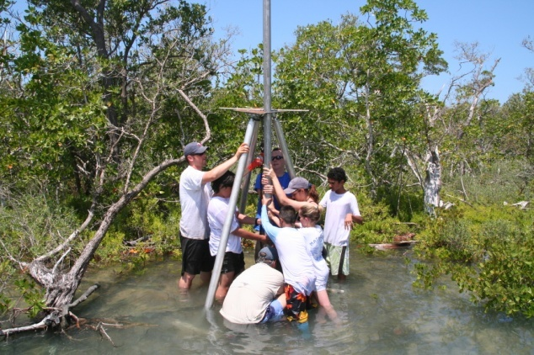
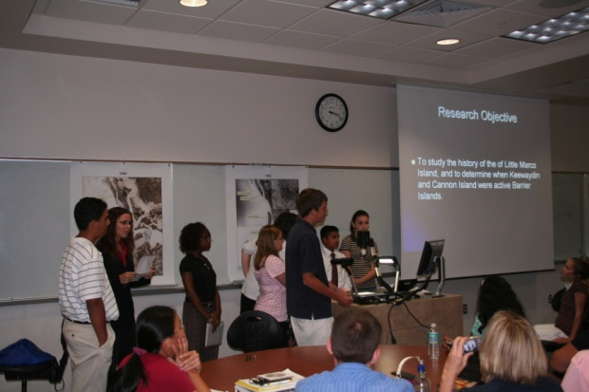
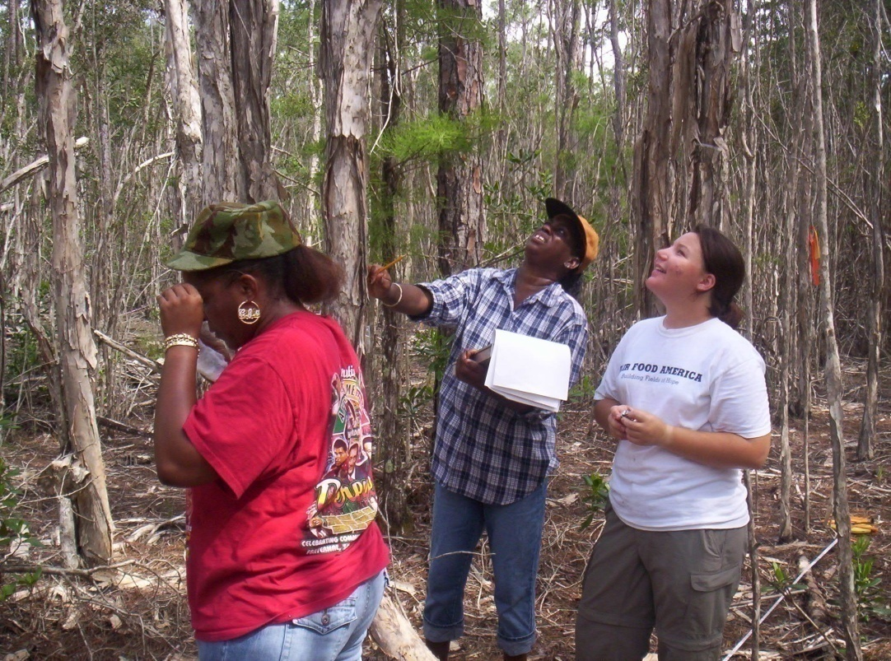
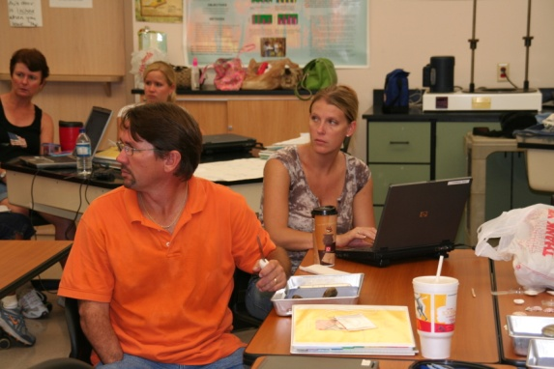
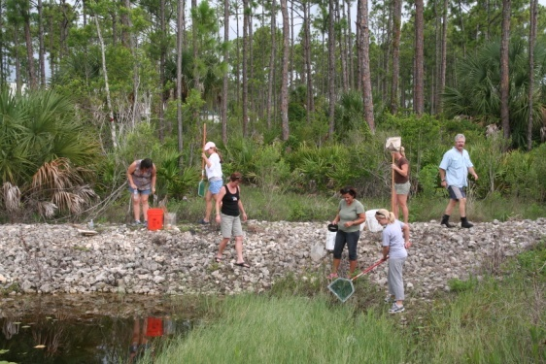
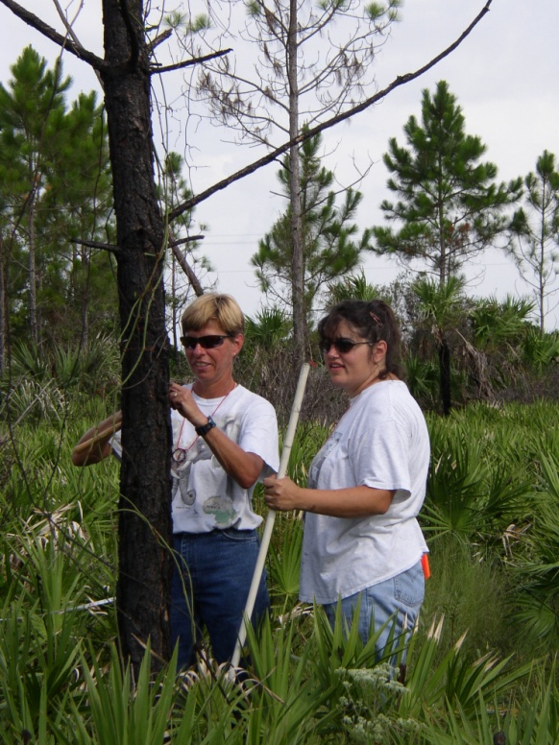
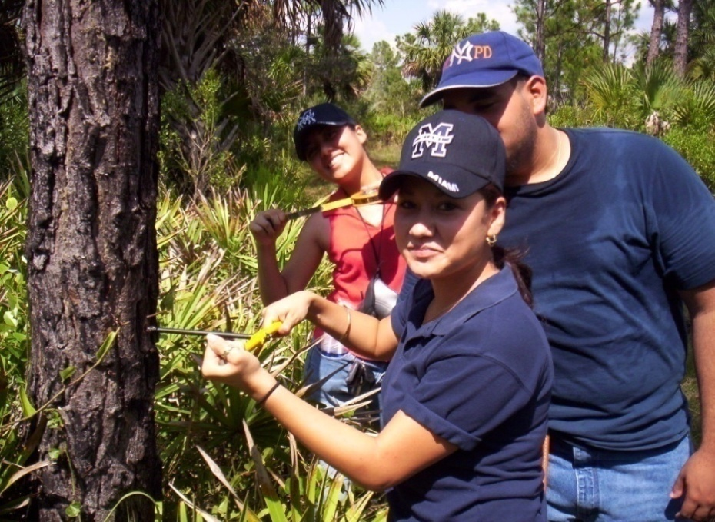
PREPARING CITIZEN SCIENTISTS VIA SCIENCE RESEARCH
OPPORTUNITIES IN SOUTHWEST FLORIDA
Nora Egan Demers, Edwin Everham, Michael Savarese, Brian Bovard, Anne Hartley, Joseph P. Kakareka, Ai Ning Loh, College of Arts and Sciences, Florida Gulf Coast University, Fort Myers, FL,
Brenda Brooks, CREW Land and Water Trust, Estero, FL, John Cassani, Lee County Hyacinth Control, Fort Myers, FL 33928, and Mike Owen, Fakahatchee Strand Preserve State Park, Copeland, FL 34137
K – 12 Education
Post-Secondary Education
ABSTRACT
In a world in which the majority of the American public gets its scientific information from media sound bites, the Whitaker Center at FGCU is involving local citizens in the scientific process to improve their understanding of science concepts and the critical role science plays in modern society.
University-sponsored initiatives in cooperation with other community organizations in which local residents and students participate include a monthly frog monitoring program, the monitoring of critical ecological processes at local parks, conservation areas and on the University campus, a Summer Research Opportunities program that engages middle school students in developing and completing research experiments such as carbon budgets and analyzing coastal geomorphology. In classroom settings at the University, students learn to become more proficient in finding and evaluating resources, and understanding the role of scientific data in decision- and policy-making. For example, in interdisciplinary global climate change course, students develop their own strategies to compare opposing theories. After learning the science, students evaluate potential impacts, adaptations and the ethics of mitigation strategies. In another course, students learn how to become more civically engaged as well as critically evaluate sources, and understand the science and technology of current issues.
University Colloquium: A Sustainable Future
A unique 3 credit-hour semester-long course required of all undergraduate students at FGCU. The goals of the course are: understanding the concept of sustainability, developing a Sense of Place, and achieving an ecological perspective. Students are required to complete 10 hours of community-based service learning within the course.
Summer Research Opportunity (SRO)
The Whitaker Center at FGCU sponsors an annual Summer Research Opportunity for up to 30 middle school students for a 2-week period each summer. Students work on a genuine research project with science faculty that has local environmental or societal significance. Students collaboratively undertake a complete research investigation from hypothesis generation and research design, through data collection, analysis, and interpretation, culminating in oral presentations during a half-day symposium.
Sample research problems considered in the past:
  - Human-affected water quality influences upon the physiology and ecology of the American oyster (Crassostrea virginica).
  - Sea-level rise’s effects upon the history of barrier island development along the Southwest Florida coast.
  - Carbon dynamics in natural areas of the FGCU campus.
Assignments include reading and responses regarding:
Connects science and civic engagement through complex, contested current and unresolved environmental issues. | Focuses on contested issues with student engagement of civic questions that require attention now. | Reveal the limits of science by identifying elements of public issues where science does not help us decide what to do
Hundreds of students enroll each semester. Service-learning required in this course since 2007. Nearly 4000 hours contributed from 2007-2008 in opportunities that connect students to their environment including: education, health, restoration, animals, environmental and social services.
Issues in Science and Technology
In these courses students examine selected contemporary science/technology issues and problems and their intellectual histories through a variety of interdisciplinary perspectives and methods. Stresses critical, creative, and collaborative thinking and application of communication, information, and technological skills.
Climate Change Science Impacts and Solutions Comprehensive exploration of global climate change that emphasizes solutions identified by students. SCIENCE Milestones in the history of climate timeline. Strategy for evaluating claims Role of the media investigated & interpreted. | Examples of 2008 Climate Change Solutions Projects Narratives of future changes to Florida’s environment, economy and society. A green issue of student-run literary publication Songs about our changing planet. Lines of clothing, jewelry A children’s book. | Student-driven inquiry directed by the scientific method | Topics from 2009 include: -Nuclear power: Good and Bad -Biofuels -Coral Reefs damaged by Global Warming -EcoG for Epilepsy treatment -Language of the Earth Charter -Stem Cell Research
Shows power of science of a public issue - Learn the basics of climate science in an historical & social context. | Locates responsibility of discovery as work of student. | An intellectual project as practical and engaged from the start. | Seeks to extract the larger, common lessons.
K – 12 Education
Science and civic engagement:
Students work on problems of regional concern;
the work generates a sense of stewardship.
Projects practical and engaging: Students are collaboratively engaged with each other, faculty and graduate students.
Summer Science Institute
The Whitaker Center strives to improve K-5 STEM education by conducting one-week long in-service training Summer Science Institutes for public elementary school teachers. Institutes are designed to: (1) allow teachers to develop inquiry-based activities; (2) provide teachers with the conceptual foundation and content to feel comfortable delivering the curriculum; and (3) address the State Science Standards and Benchmarks. Institutes bring teachers and FGCU STEM and STEM education faculty together to develop lesson plans in a given scientific discipline.
Limits of science: Teachers gain an appreciation of the imperfections of scientific investigation. | Projects practical and engaging: Teachers and students are engaged in inquiry-based science activities. | Scientific knowledge and method: Teachers develop an appreciation of science through the development of research exercises.
Forest Dynamics Plots
A network of sites to study the impact of natural and anthropogenic disturbance on forest ecosystems
Working with partners in public land management, we are establishing a network of long-term forest study plots throughout southwest Florida, to examine the impact of disturbances (hurricanes, fires, exotic infestation) on forest dynamics. This project provides opportunities for field experience and long-term data to expose science majors and non-majors to the scientific process.
 | Plot-based student research projects have included: - Hurricane impacts - Distribution of epiphytes - Soil macroinvertebrates - Soil litter dynamics - Impacts of invasive species - Herpetofauna studies
Connects & engages: forest plots are placed to meet research needs in the region | Science: practical and engaged: Students build off plot network & develop research projects | Science knowledge & methods: Students engage -data collection for on-going projects
Focusing on contested issues:
Research on complex problems
such as global climate change, water management and land-use change.
Scientific knowledge and method: Students learn about the practice and philosophy of science through a genuine research project. Photo: Students presented during a research symposium with friends and family in the audience.
Approximately 30 teachers have completed institutes thus far. These teachers are employing and sharing inquiry-based activities within five elementary schools in Collier County, Florida. In the future, teaching activities will be uploaded to a national digital library for further dissemination.
SRO has run consistently for the last 6 summers, involving anywhere from 25-40 students per summer, producing a total of over 180 alumni. Many of these students have competed successfully at regional, state, and international science fairs; a number have transitioned to college and are studying science or mathematics.
Over 300 students from both non-majors general education courses and courses required for Environmental Studies majors have participated in data collection on these forest plots. This plot research has generated 11 senior research projects and four poster presentations at conferences.

