Slide 1
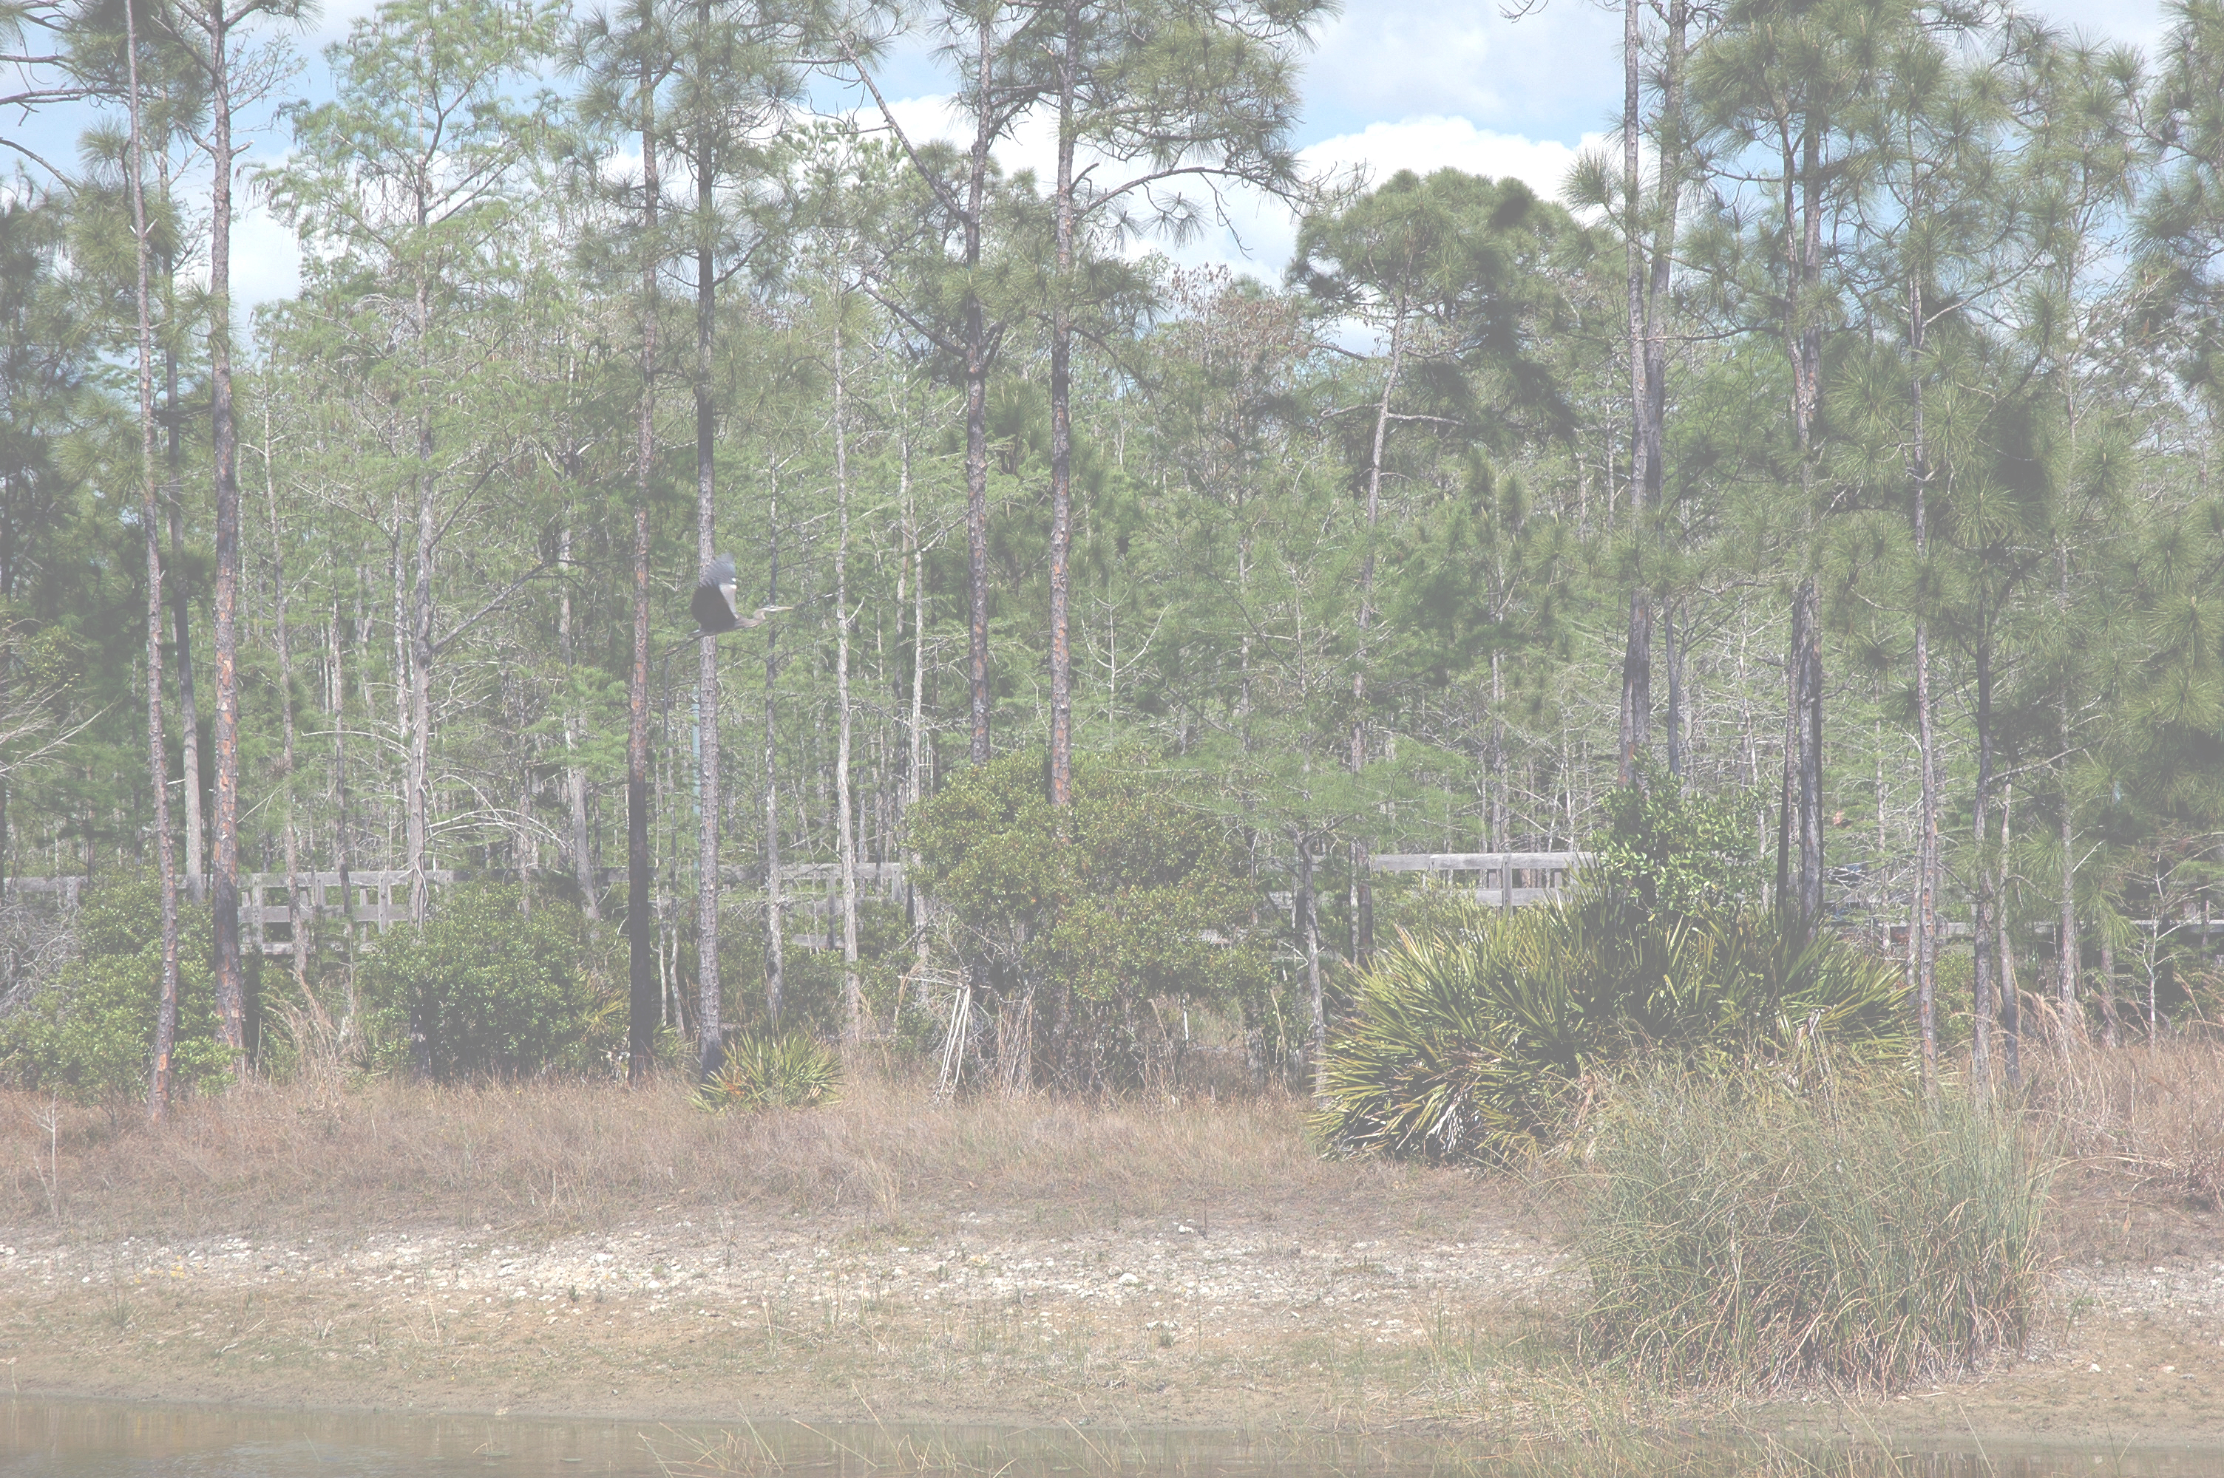
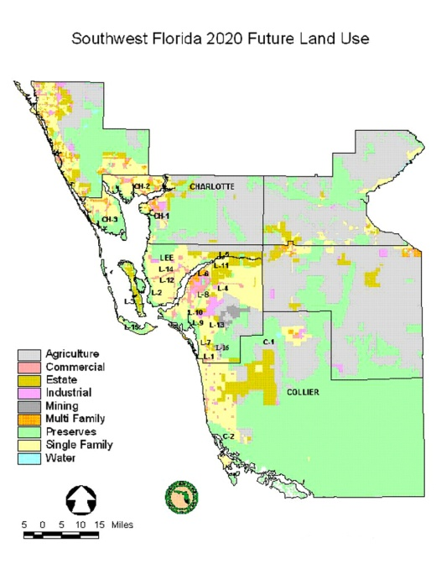
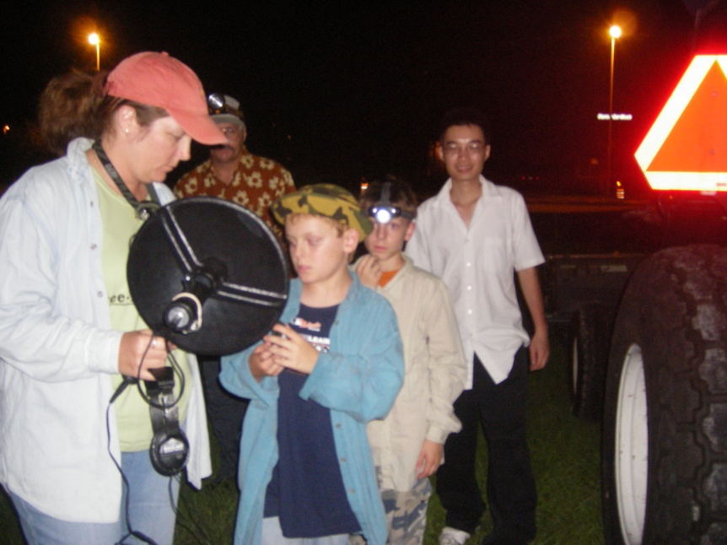
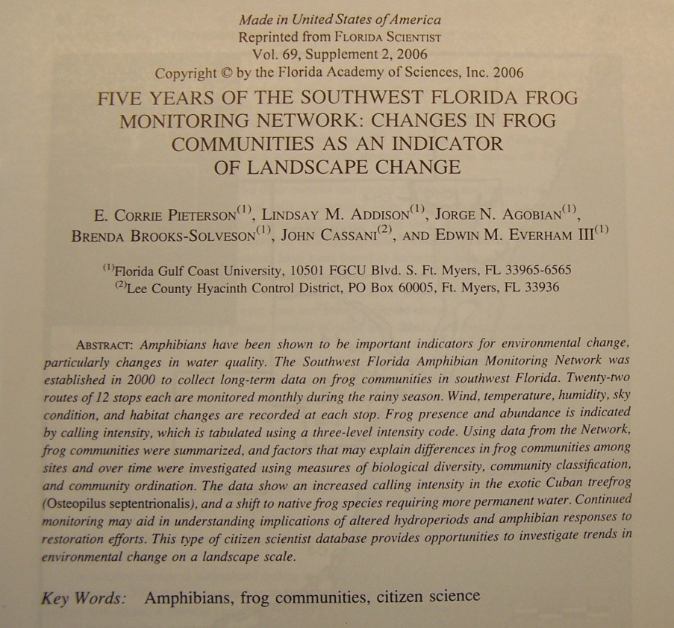
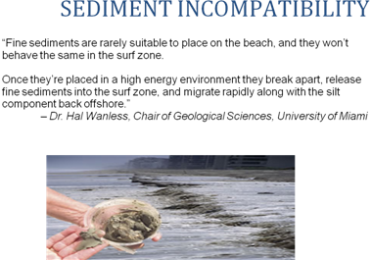
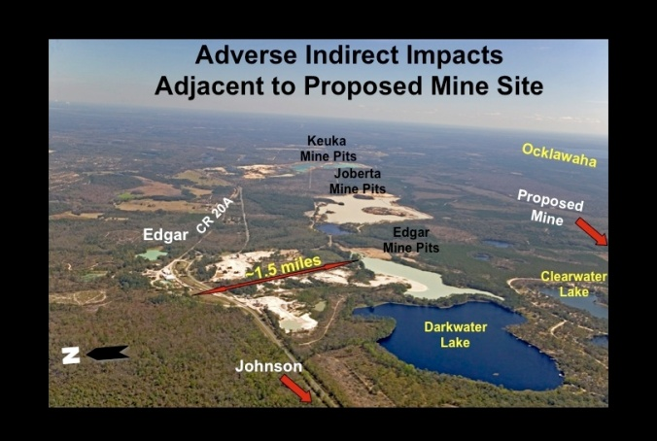
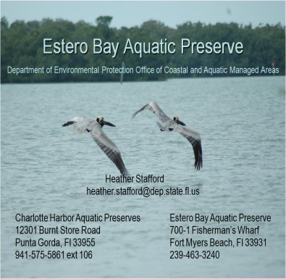
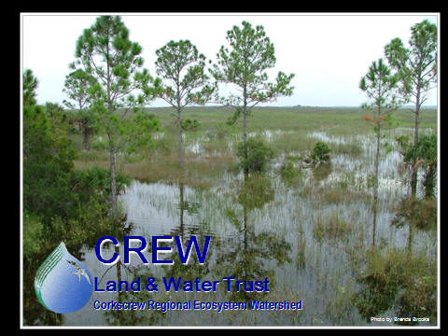
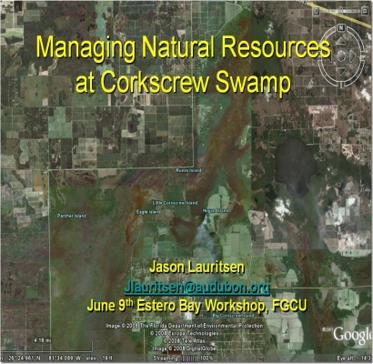
PREPARING CITIZEN SCIENTISTS VIA SCIENCE RESEARCH
OPPORTUNITIES IN SOUTHWEST FLORIDA
Nora Egan Demers, Edwin Everham, Michael Savarese, Brian Bovard, Anne Hartley, Joseph P. Kakareka, Ai Ning Loh, College of Arts and Sciences, Florida Gulf Coast University, Fort Myers, FL,
Brenda Brooks, CREW Land and Water Trust, Estero, FL, John Cassani, Lee County Hyacinth Control, Fort Myers, FL 33928, and Mike Owen, Fakahatchee Strand Preserve State Park, Copeland, FL 34137
Community Education
Florida Gulf Coast University continuously pursues academic excellence, practices and promotes environmental sustainability, embraces diversity, nurtures community partnerships, values public service, encourages civic responsibility, cultivates habits of lifelong learning, and keeps the advancement of knowledge and pursuit of truth as noble ideals at the heart of the university’s purpose.
Guiding Principles: Informed and engaged citizens are essential to the creation of a civil and sustainable society. Service to Southwest Florida, including access to the University, is a public trust. Connected knowing and collaborative learning are basic to being well educated.
FROGWATCH: Southwest Florida Amphibian Monitoring Network
A collaboration between citizen scientists and scientists in training
In 1998 the frog monitoring network was established, following the protocols of the North American Amphibian Monitoring Network. The network has grown to 23 routes in three different counties. Students and other citizens, including the Cub Scouts, participate in monitoring.
Focusing on contested issues: changes in frog communities are used as an indicator of the impacts of land-use changes in southwest Florida. | Science and civic engagement: citizen volunteers experience the importance of long-term monitoring in understanding complex environmental systems | Science of a public issue: Graduate students used the database and applied advanced statistical techniques to illuminate patterns of change.
The frog monitoring network is completing ten years of data collection involving over 100 volunteers. Two meetings are held each year to: orient new route leaders at the start of the monitoring season and to share results at the end of the season. Local media coverage has helped communicate the goals and results of the project and to recruit new volunteers.
First International Conference on Mining Impacts to the Human and Natural Environments
a meeting co-organized by N. Demers
The conference focused on adverse impacts from mining currently not addressed or evaluated by regulatory agencies and municipalities, as well as alternatives to mining and approaches for improved monitoring and evaluation of existing and proposed mine sites and mine-related impacts.
CELA TEGA:
A series of public meetings co-sponsored by FGCU
Cela Tega is the southwest Florida native (i.e.: Calusa) term for “a view from high ground”. The term was inspired from the Carib native North American term epopopanana: this is meeting (Epopo) + and (ana) + place (Pa). The purpose of these meetings is to convene public & private land managers in the Estero Bay Watershed to identify common challenges for focusing future activities for the Estero Bay Agency on Bay Management; a non-regulatory advisory committee to the Regional Planning Council. Its directive is to make comments and recommendations regarding the management of Estero Bay and its watershed.
 |  | Graphic by Sydney Bacchus, PhD
Focusing on contested issues - Speakers included local residents addressing safety and quality of life issues impacted by mining. | An intellectual project as practical and engaged from the start - Engaged residents taking on real issues in meaningful ways. | Seeks to extract the larger, common lessons - providing scientific evidence for elected officials to make important decisions.
An intellectual project as practical and engaged from the start | Power of science for engagement of a public issue | Seeks to extract the larger, common lessons from the issues
Participants included local residents, staff from elected State representatives, newspapers, scientists, public officials and staff. mpacts include changes to local ordinances, permits, regulatory oversight made possible by enhanced community engagement.
Agencies and public groups participating including: federal, state, and local agencies and private for profit and non-profit organizations involved in land management issues such as: ecological restoration, exotic species control, public land acquisition programs, and private mitigation banks.

