Slide 1

Using 3D water models to investigate fundamental and powerful concepts in the biological sciences
Nora Egan Demers
Joanna Salapska-Gelleri

Slide 2


Fundamental and powerful concepts
Basic concepts that lie at the heart of a discipline (Nosich, 2005)

Slide 3
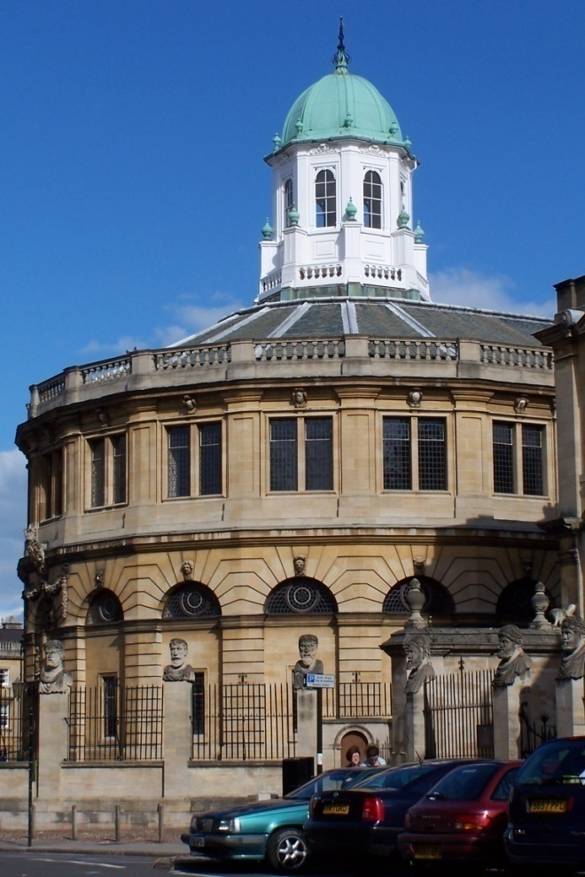
Background- How we got here
Whitaker Center sponsored
support to attend Gordon Research Conference –(confidential)-
but the NSF sponsors pre-conference workshops we can talk about!

Slide 4
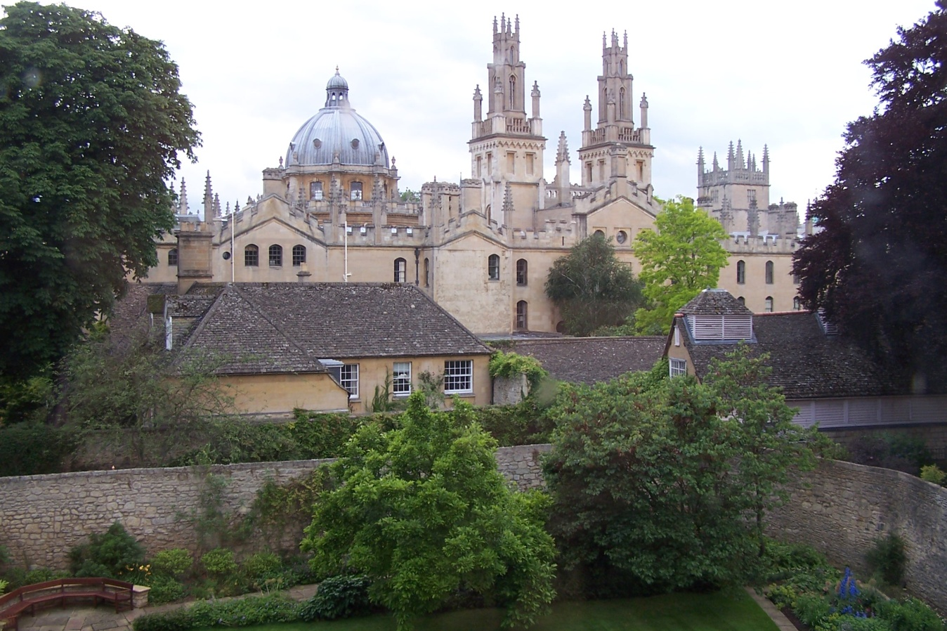
GRC VISUALIZATION IN SCIENCE & EDUCATION
    July 3-8, 2005
    The Queen's College
    Oxford, United Kingdom

Slide 5
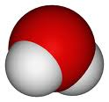
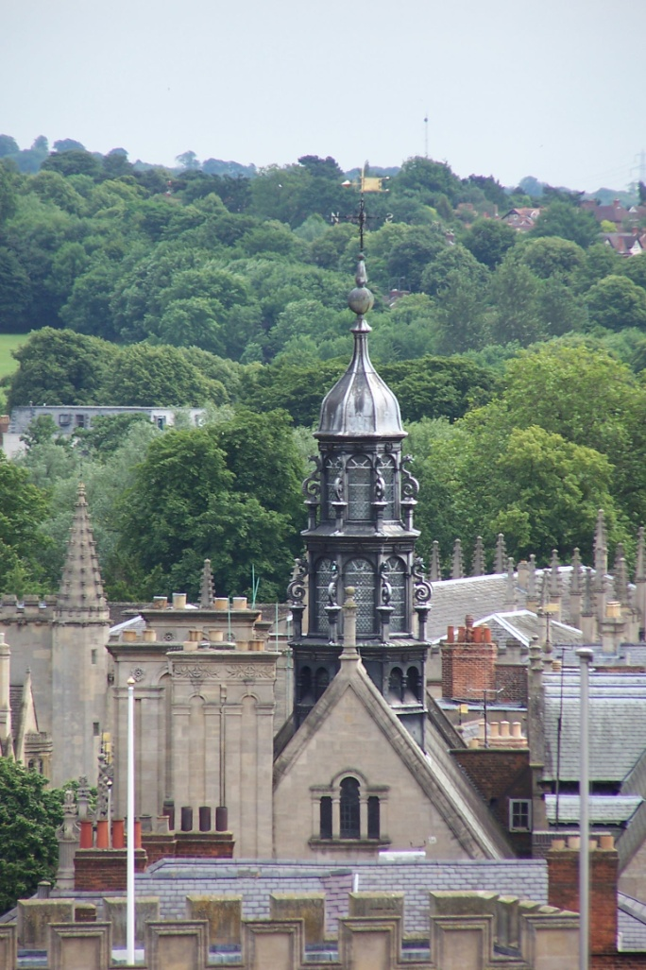
Whitaker Center for STEM education sponsored participation in GRC pre-conference workshop
  Introduced to concepts of
    perception
    storyboard methods to assess and compare textual to visual representations
    Haptics- 3D molecular models magnets to show properties of water

Slide 6

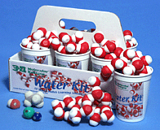
    Haptics-
    3-D Molecular
    Designs
    Models properties of water using magnets

Slide 7
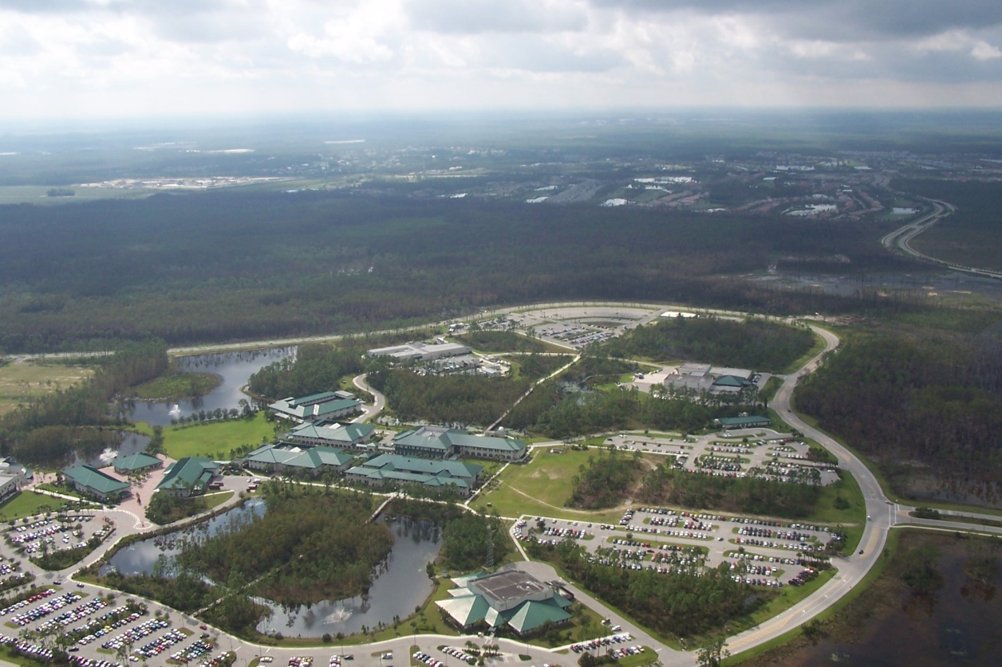
“Teaching Cell” assignment 2006
    Demers and Salapska-Gelleri
      Walks around loop road
      Lunch
      Brainstormed on shared interests
      IDS, learning, biology, cognition, etc

Slide 8
FGCU Demographics of course
(Freshman) General Biology I for majors, health professions, forensics, environmental studies, marine science and General Education science with lab (semester-long)
FGCU grew from 1500 students at inception in 1997 to over 10,000 FTE today
2006-2007 Freshman Class Profile
  Top 10 percent of high school class: 16%
  Top 25 percent of high school class: 46%
  Top 50 percent of high school class: 84%

Slide 9
Learning Outcomes
Structure function relationship reinforced
Greater understanding of role of electronegativity in emergent properties of water
Types of bonds- Ionic vs Polar covalent bonds versus hydrogen bonds (inter vs intramolecular forces)

Slide 10
Learning Outcomes cont’
knowledge of emergent properties of water based on polarity (caused by differences in electronegativity)
  Cohesion/Adhesion
  Versatile solvent
  Expansion upon freezing
  Moderate temperatures (not addressed)
Hydrophobic/ydrophilic
data analysis especially variation
  Integrate explanation into lecture interspersed with activities

Slide 11
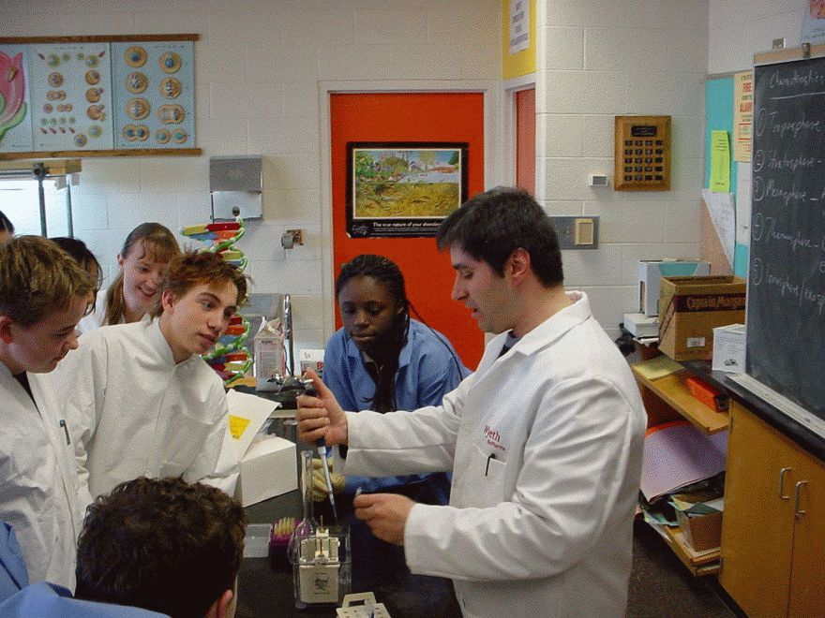
Skills Acquisition
Critical thinking
Pipetting
*Data analysis statistics
*Experimental variation vs natural variation
Scientific Process:
  Building on prior knowledge

Slide 12
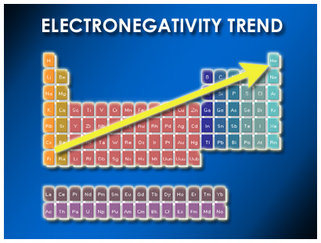
Electronegativity

Slide 13
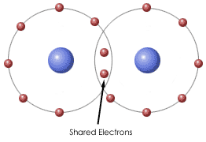
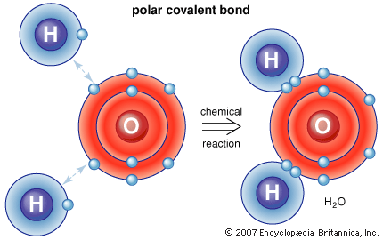
Polarity of water
What are types of bonds (recall from prior classes)?
Bonding- covalent - sharing of electrons
If unequal sharing- polar covalent

Slide 14
Polarity of water
Explain how magnets simulate polarity of water brought about by electronegativity
Note that colors for hydrogen and oxygen used are those used in most texts
Model strength of polar covalent bonds by having them remove H from O

Slide 15
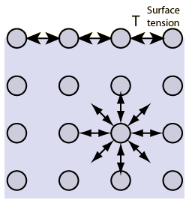
Cohesion/surface tension
Cohesion and Surface Tension
The cohesive forces between molecules down into a liquid are shared with all neighboring atoms. Those on the surface have no neighboring atoms above, and exhibit stronger attractive forces upon their nearest neighbors on the surface. This enhancement of the intermolecular attractive forces at the surface is called surface tension.

Slide 16
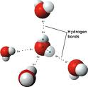
Cohesion in water
How do well water molecules stick to each other?
What do you recall about properties of magnets?
note orientation of hydrogen to oxygen and similarity to magnets
      Models sometimes are very realistic

Slide 17
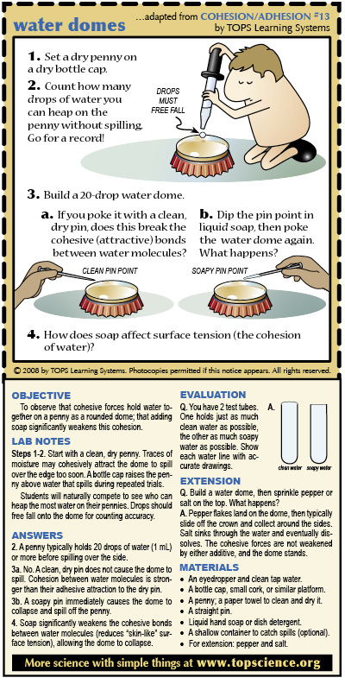
Cohesion/surface tension activity
How many microliters of water can you each place on a penny?
Collect class data analyze mean and standard error and
Compare to class height data (from previous lab)
compile reasons for variability in data collection and natural variation

Slide 18
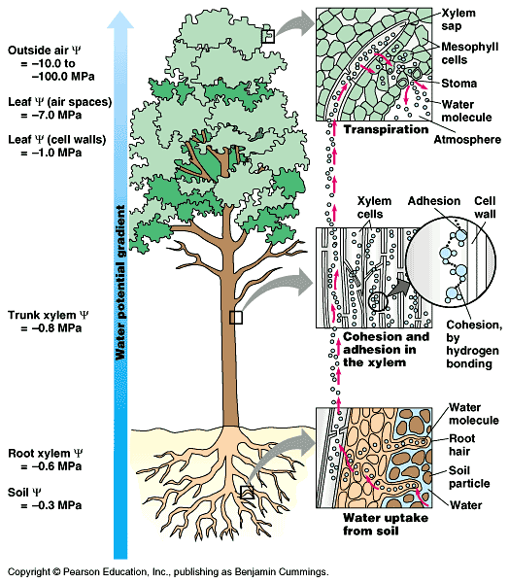
Cohesion/adhesion activity
Practice with models - note how well they stick to each other
Note how they stick to the white board and can be ‘pulled’ up (like water up a tree)

Slide 19
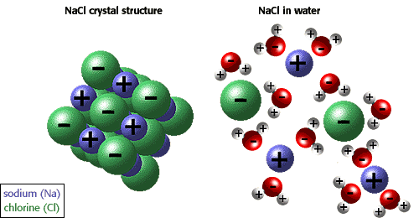
Solubility property of water
Examine how sodium and chloride interact with water- note orientation of water molecules to element solubilized

Slide 20
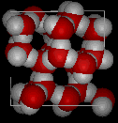
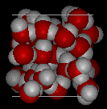
Ice lattice- right before break- competition between groups for ice- cycle ‘cube’ fastest then turn it back into liquid ☺

Slide 21
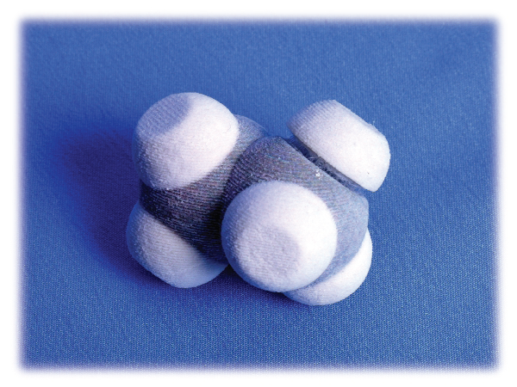
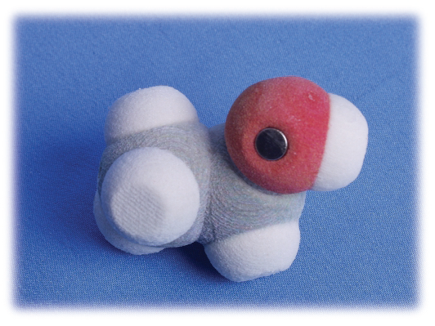
Hydrophobicity/hydrophilicty
After break- preview of cell membrane properties
Look at gray model- what is different from water?
Replace one H with ‘hydroxyl’ group
How well do they stick to each other and to water models?

Slide 22
What we did
What is a “fundamental and powerful concept” in Biology (and other natural sciences)?
Drafted storyboard to assess student understanding of knowledge before and after using cool magnets in hands-on learning approach in Gen Bio I
Approach Ed. Researcher with idea- she suggested 3rd box to extend to assess their understanding of higher level application – how does water go up a tree?
Submit IRB and devise informed consent

Slide 23
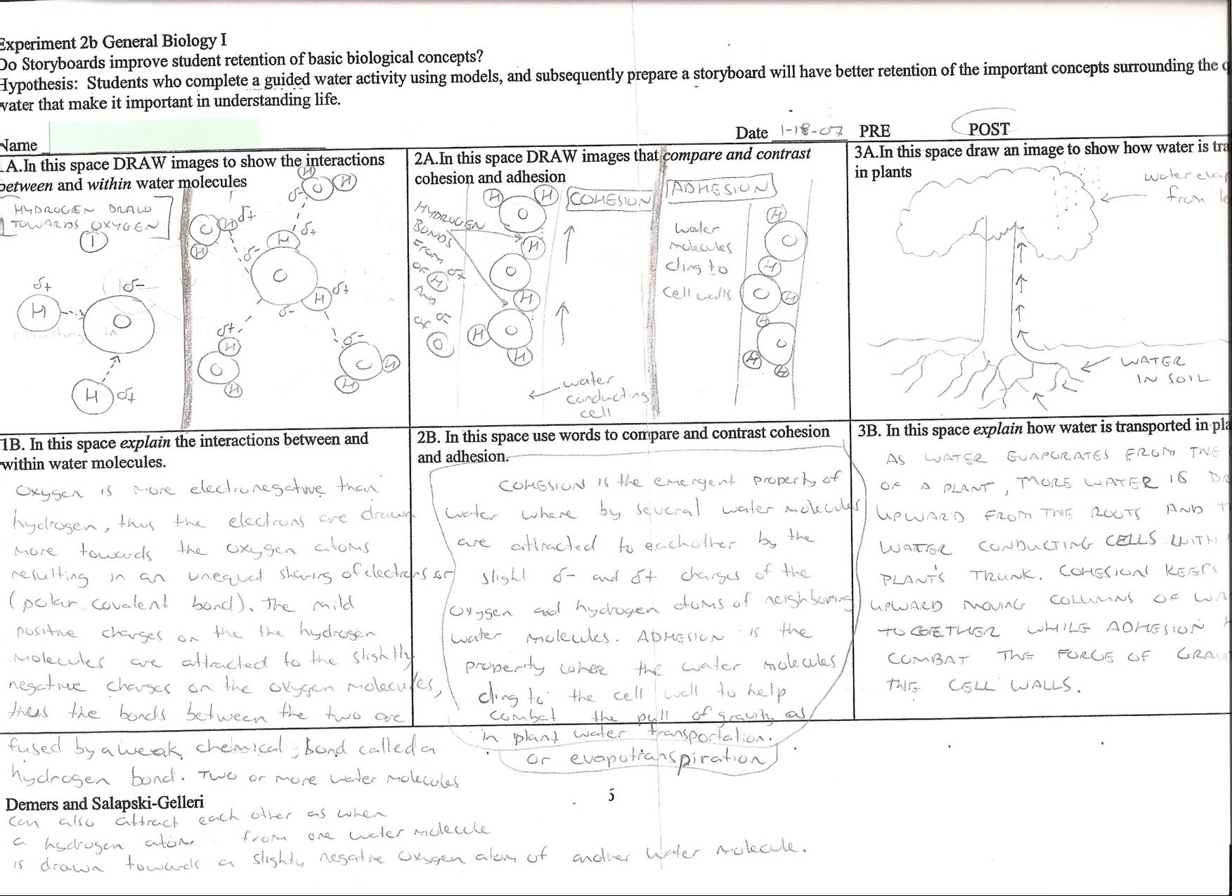

Slide 24
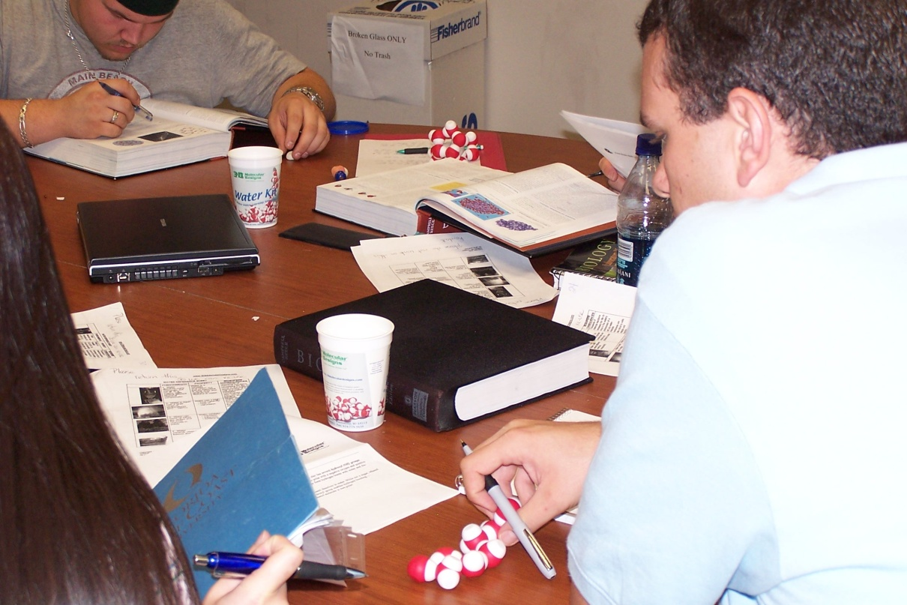
Storyboard pilot
Invited colleagues to implement in their sections- we would score and return (if desired)

Slide 25
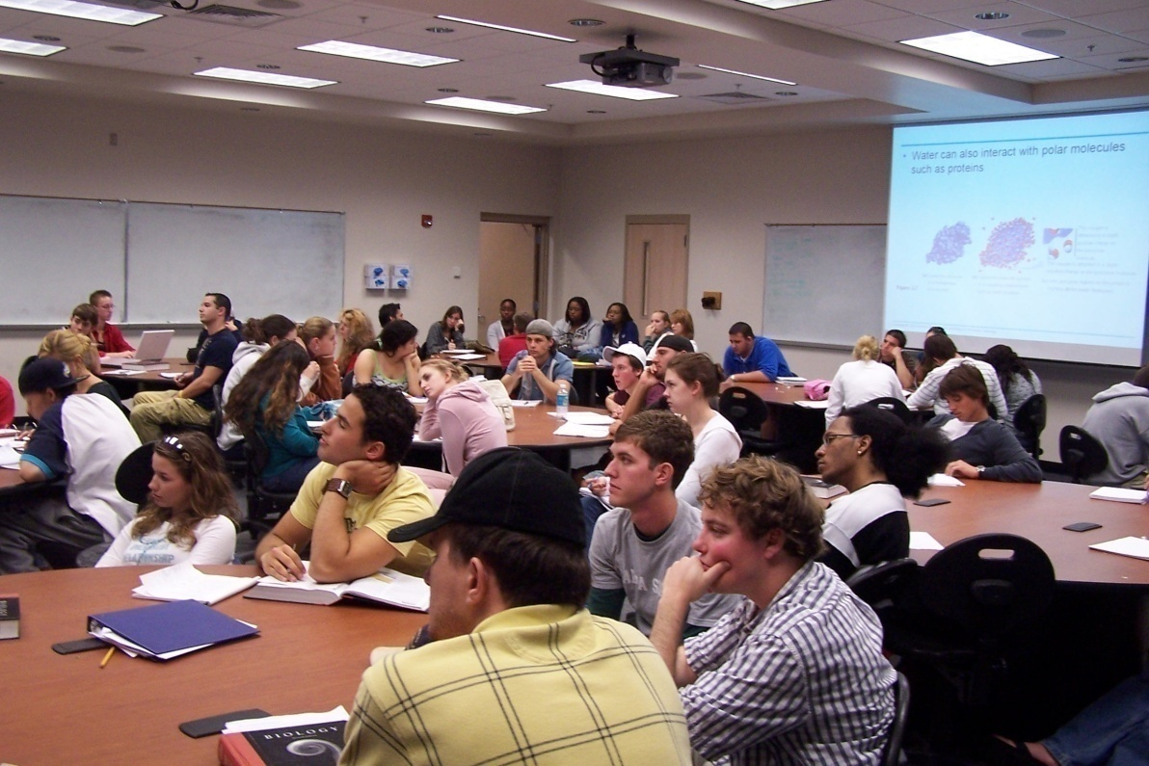
What we did-variations on theme
Pre-quiz
“lecture”
Activity, worksheet
Post-quiz

Slide 26
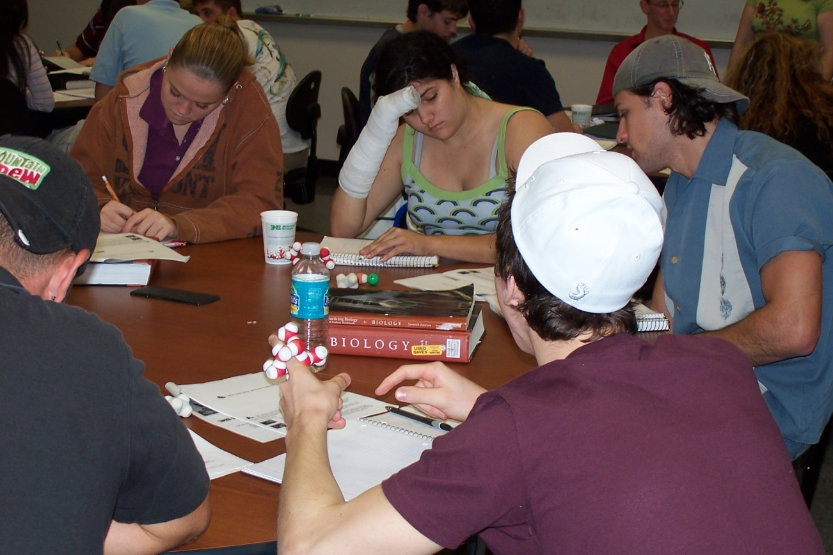
Pilot project- Storyboards on chemical properties of Water
Freedom for each instructor to implement as desired
  Allowed comparison of teaching methods

Slide 27
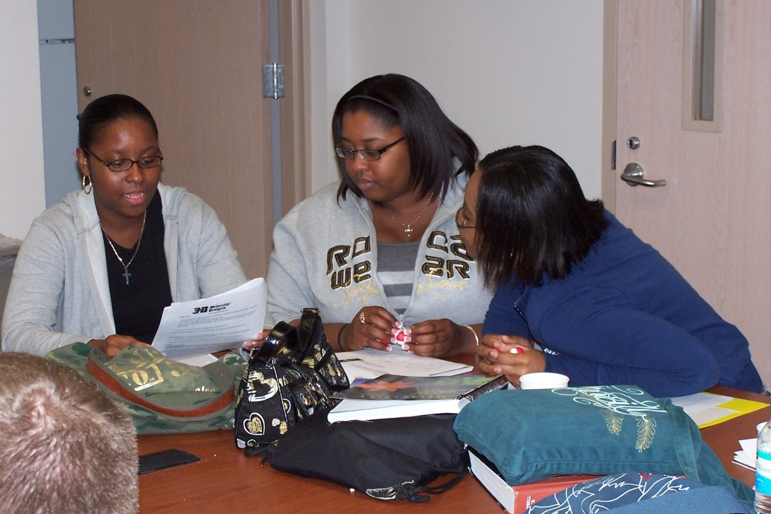
Show rubric here
Scored and refined rubric
Check for consistency in scoring
Entered data

Slide 28
Preliminary Analyses Conducted
Scores based on collapsed values for Boxes 1 and 2.
Comparison of baseline knowledge for written versus graphic water properties.
Gains from class activity as a function of Pre and Post test performance.
Evaluation techniques: concurrent, homework, in-class post.

Slide 29
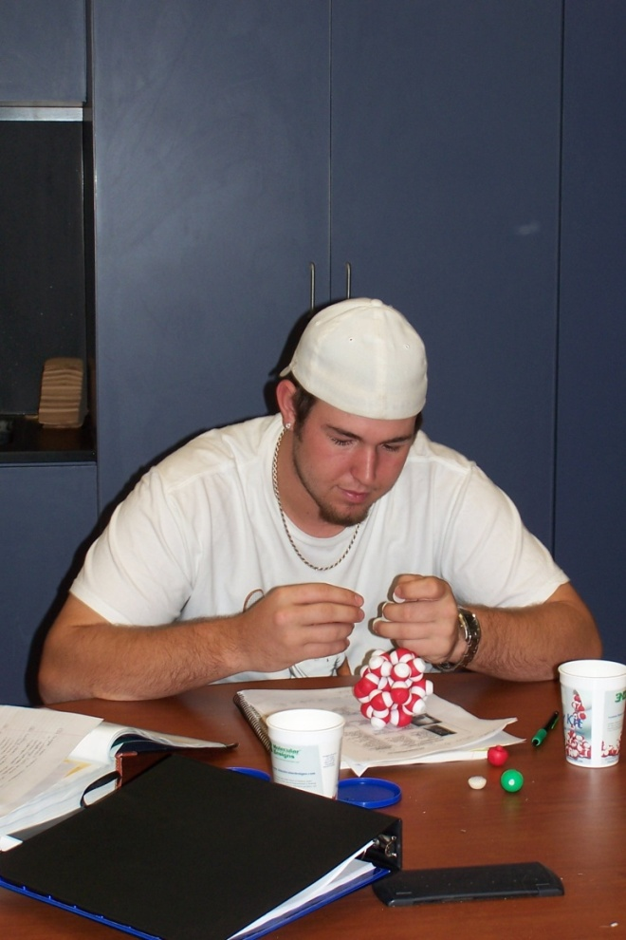
Pilot project- Storyboards on chemical properties of Water
Comparison of Methods
Pre-test, in-class activity, post-test.
Pre-test, in-class activity, post-test as homework.
Concurrent in-class activity and worksheet.
Laissez-Faire post-test.

Slide 31
What did they retain?
In two of sections the post was done again during DNA replication chapter
  Tried to reinforced importance of distinguishing hydrogen and covalent bonding properties
  Those data showed:

Slide 34
What we’ve learned so far- qualitative
Motivation to complete task influences success at demonstrating concepts
Motivations that are effective include grading (most importantly--it has to count!)
They showed better learning on “post” that was homework or filled out during activity
They need very careful guidance to be able to demonstrate even basic knowledge immediately after activity (spoon feeding?)

Slide 35
What else we’ve done
Reassessed later in term and in upper-division classes
Compare to other benchmarks
  class grade, etc
Intro to Geology using models for role of water in properties of clay- comparing and refining teaching techniques. One faculty member now designs her entire class around water!
(less success in getting biology colleagues to use models or assess learning of the concept as fully)
How might this be achieved?

Slide 36
Does knowledge of water properties relate to scores in upper-division courses?
Vertebrate Form and Function grade compared to worksheet score: worksheet completed first week of class as ungraded un-announced task. Very strong correlation to final grade in class (totally unrelated content).
Does this just tell us ‘good students’ are good at everything?
Can we find a way to see if knowledge of water improves success in other topics?

Slide 37
Do students recall properties of water in upper-division biology classes?
In a word- NO --students currently enrolled recall very little diagramatically or textually
Will their understanding improve as we get current students who have used the models in these classes?
(Will need to alter worksheet to collect information on whether they used the models (and how)

Slide 38
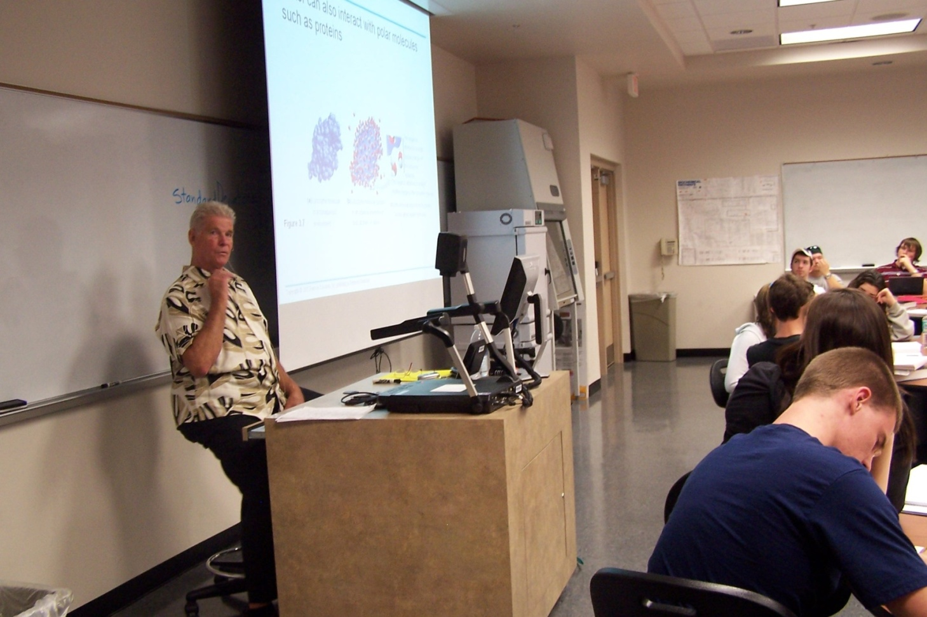
Can it play a valuable role in program assessment?

