Slide 1

Gopher the Cache!
2008-2009
Teacher training for ecological literacy…

Slide 2

Gopher the Cache!
2008-2009
Purpose: to use GPS technology to develop and explore curriculum about Lee County environmental features specifically upland habitats of gopher tortoises

Slide 3

Afternoon Session (12:30-3:30)
Overview-
  Threatened and endangered species features
  Upland habitat overview
  Native and invasive species overview
  Gophers favorite foods
  Brief overview of Yellow Fever Creek Preserve Resources
  Digital library resources
Walkabouts (1:30-3:30)

Slide 4
Walkabout
  Campus habitats and landscaping for environmental sustainability
    swales- dry detention around parking lots
    different forest types- cypress, oak hammock, pine
    Invasive exotics and biological control agents for melaleuca
  Forage monitoring techniques- hands on training

Slide 5
Threatened and Endangered Species
What plants and animals do you know of that are threatened with extinction?
Why do species become endangered?

Slide 6
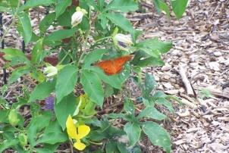
The big 6 reasons that make some animals more prone to extinction than others:
1. migrate ... depend on several different habitat areas
2. interfere in some way with people's activities ... kill livestock, eat or ruin
inhabit lands humans want, or are collected by humans
3. have very specific food or nesting requirements ... specialized
4. are very sensitive to changes ... sensitivity to chemical changes, competition from exotics
5. have small broods and long gestation periods ... high birth rates equal more opportunity to acclimate or adapt
6. are naturally rare ... or have a limited range

Slide 7
Scientific Names- or how to look smart when writing about organisms
Genus species (always italicized or underlined)
Genus has a capital letter
species is always lower case
Gopherus polyphemus or Gopherus polyphemus
Are both correct ways to ‘scientifically” describe the gopher tortoises!

Slide 8
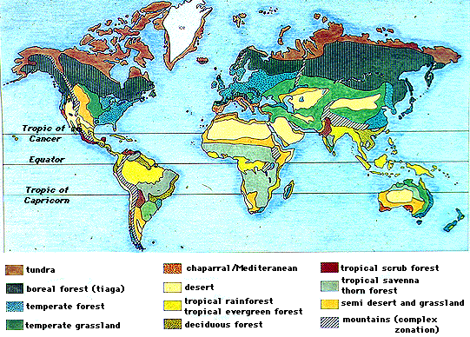
Biomes

Slide 9
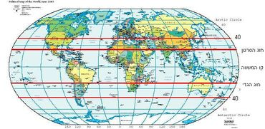
Ecosystem type- Subtropical climate refers to zones in a range of latitudes between 30/40° and 45°. The hot season duration is longer, while the cold season is milder and rainy. A sub-type is the Mediterranean climate.

Slide 10
Commensals
Humans and plants are also commensals- they help make the environment suitable for each other…
Plants take in carbon dioxide (CO₂)and make “sugars (hydrocarbons)” by doing so, they generate oxygen (O₂).
Organisms (animals including humans and plants!) take in oxygen to break down sugars (generate energy to grow/metabolize etc!) and release carbon dioxide!

Slide 11
Do plants take in “air pollution”?
Not if you are talking about common toxicants like mercury or metals (these they may absorb through their roots)
If you call carbon dioxide a pollutant, then the answer is YES!
  Think Global Warming from burning of fossil fuels (hydrocarbons that release CO₂ when broken apart) to release ENERGY for us to consume!
  That is why they want us to plant trees and preserve forests to help combat global warming!

Slide 12
Upland habitats
Virtual tours
http://ruby.fgcu.edu/courses/everham/KnowYourPlants/
Take the FGCU campus boardwalk tour!
The Tour from Whitaker Hall to Parking Lot 7
The Tour from Academic Building 3 to Parking Lot 3
Biographical Sketches of Boardwalk Plant Species

Slide 13
Gopher tortoises favorite foods available in SW Florida- they will try anything at least once!
Wire grass
Sedges
Periwinkle
Fig leaves
Vines
sprouts
Plants abundant at Barefoot Beach
  Sea oat and sea grapes
  Wire grass
  Sedges
  Periwinkle
  Fig leaves
  Golden Beach creeper
  Vines
  Sprouts
  Lantana
  Paint brush plant
  Railroad plant
  Bay bean

Slide 14
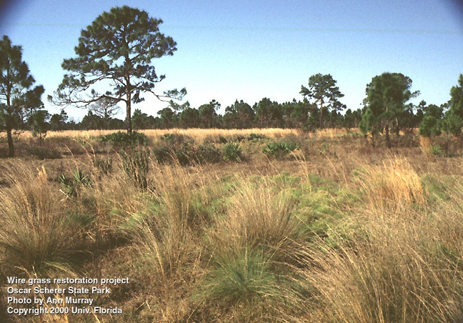
WIRE GRASS
http://aquat1.ifas.ufl.edu/oscarsherer2.jpg

Slide 15
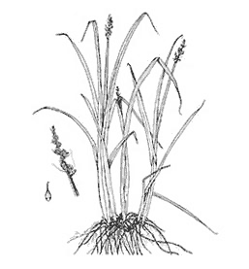
Sedges
There are many types of sedges (over100) and they are difficult to identify without using detailed botanical keys. In general, sedges are perennial plants that resemble grasses, grow in shallow water or moist soils, and can reach 4 feet in height. Sedges often grow in thick clusters or tussocks. Stems of sedges are usually triangular. Spikes occur on the upper sections of the plant and can be single or in groups.
http://aquaplant.tamu.edu/database/emergent_plants/sedges.htm

Slide 16
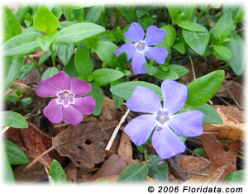
Periwinkle
Common periwinkle is a fast growing vine with slender woody stems that sprawl along the ground, rooting at every node. The leaves are evergreen, opposite, about 2 in (5 cm) long and elliptic in shape.
http://www.floridata.com/ref/V/vinc_min.cfm

Slide 17
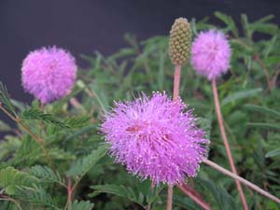
Sunshine mimosa

Slide 18
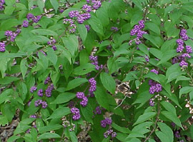
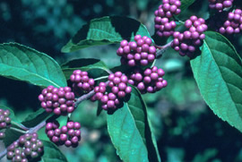
Beautyberry
http://www.caes.uga.edu/departments/hort/extension/Goldmedal/winners/2002/winners2002.html

Slide 19
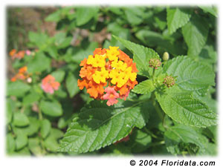
Lantana
Common lantana is a rugged evergreen shrub from the tropics.
http://www.floridata.com/ref/L/lant_c.cfm

Slide 20
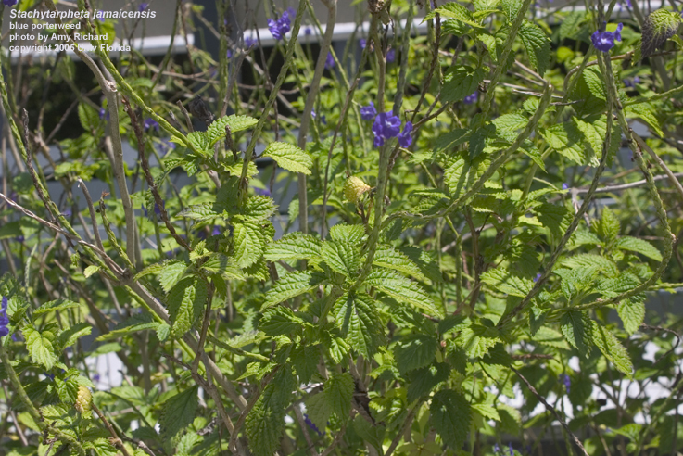
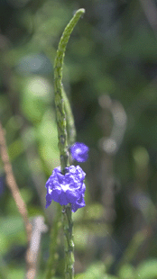
Porterweed
http://aquat1.ifas.ufl.edu/stajam_dig5_lr.jpg

Slide 21
Digital libraries commercial
NSDL- http://nsdl.org/
BEN http://www.biosciednet.org/porta

Slide 22
Yellow Fever Creek Preserve
http://www.conservation2020.org/preservedetails.cfm?proj_no=298
Land Stewardship Plan excerpts in your portfolio
  Hope it will help apply these concepts in an inquiry-based fashion with the students
  I look forward to seeing you and your classes during Field trips this December
  Do not hesitate to contact me if you have any questions.

Slide 23
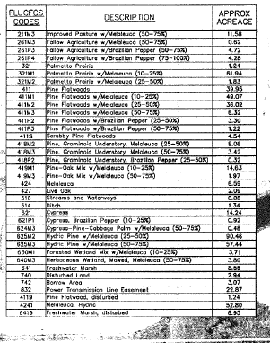
FLUCCS- habitat types- use these data and the records in Plan to locate where the tortoises are at YFCP and help determine where we’ll do the forage surveys

Slide 24
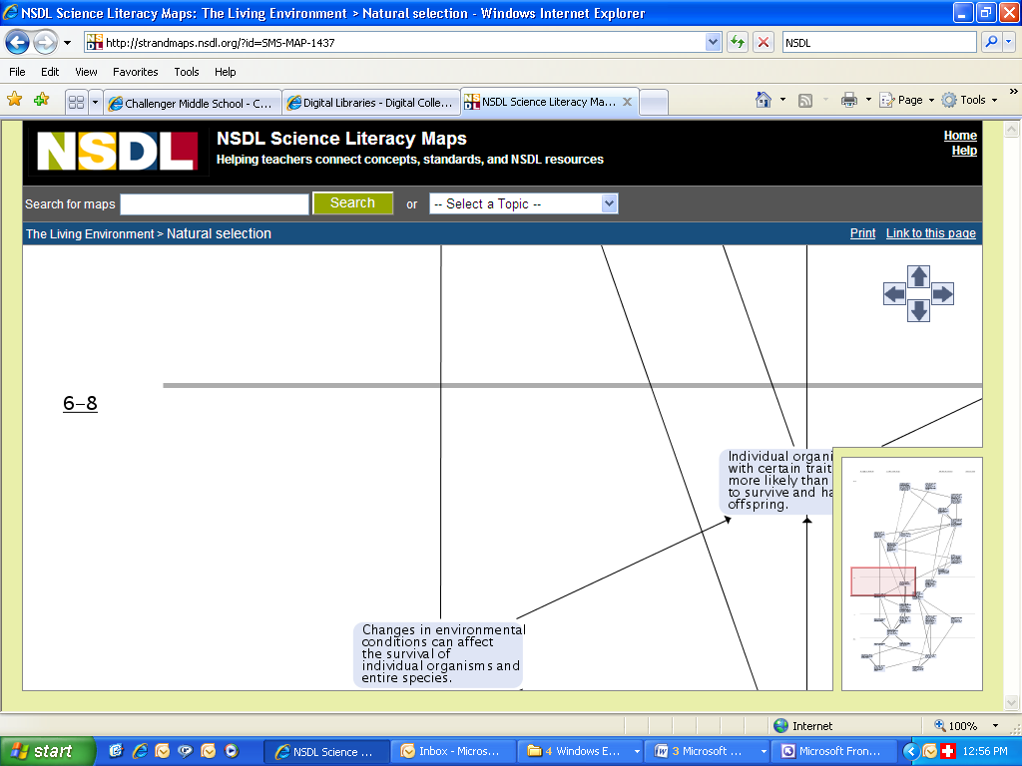
NSDL --science literacy maps

Slide 25
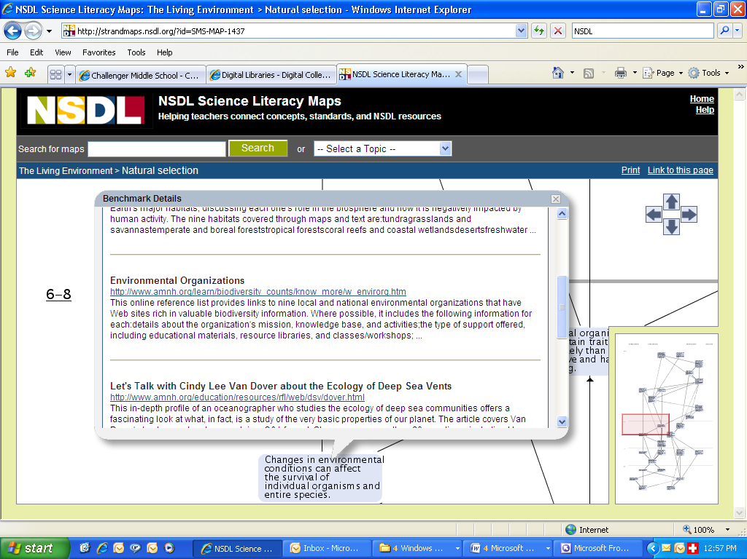

Slide 26
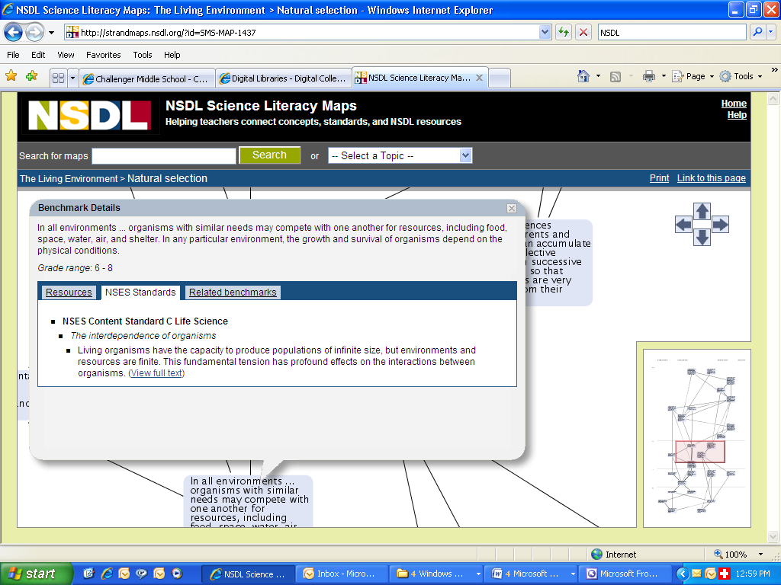

Slide 27
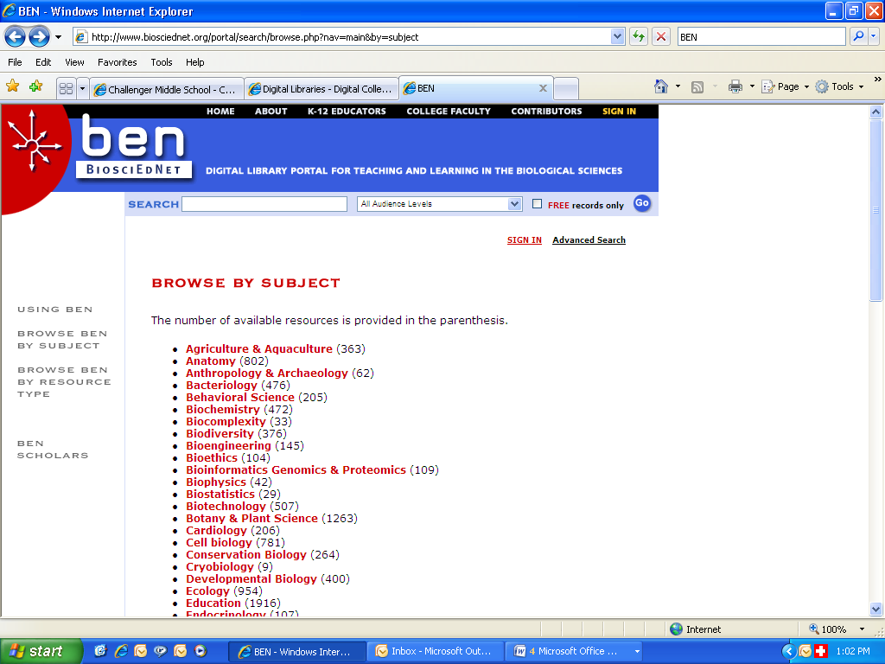

Slide 28
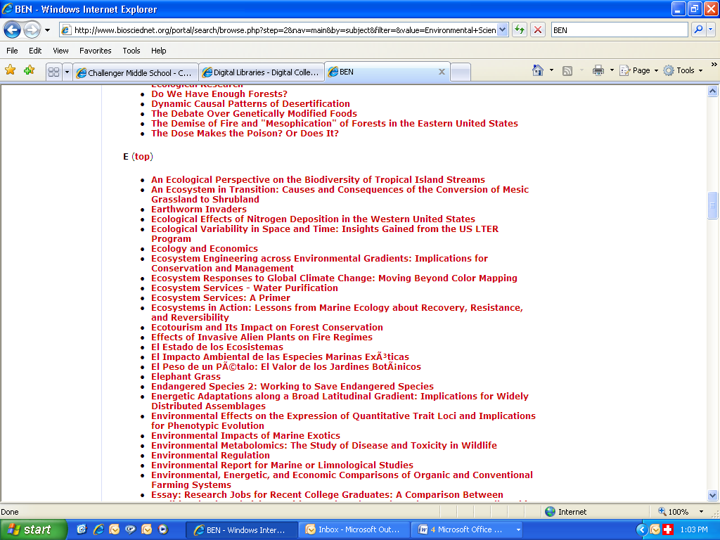

Slide 29
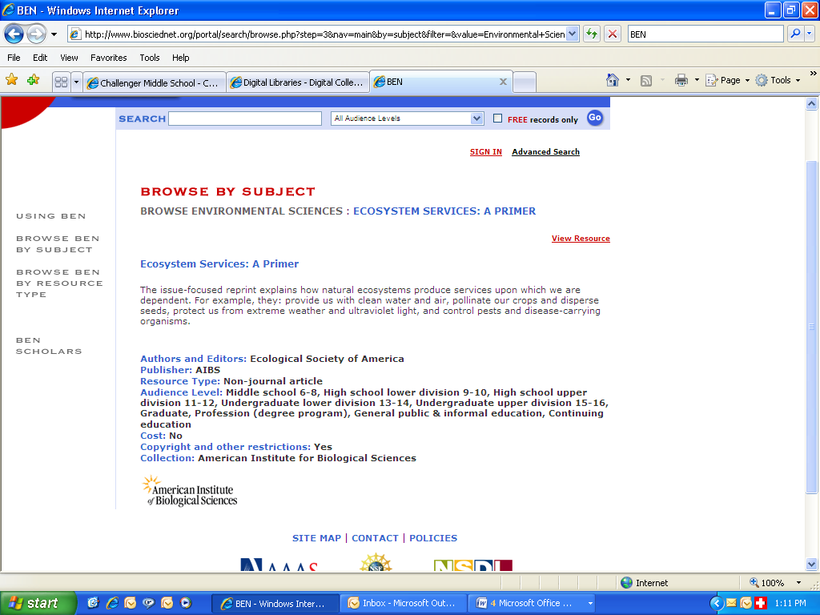

Slide 30
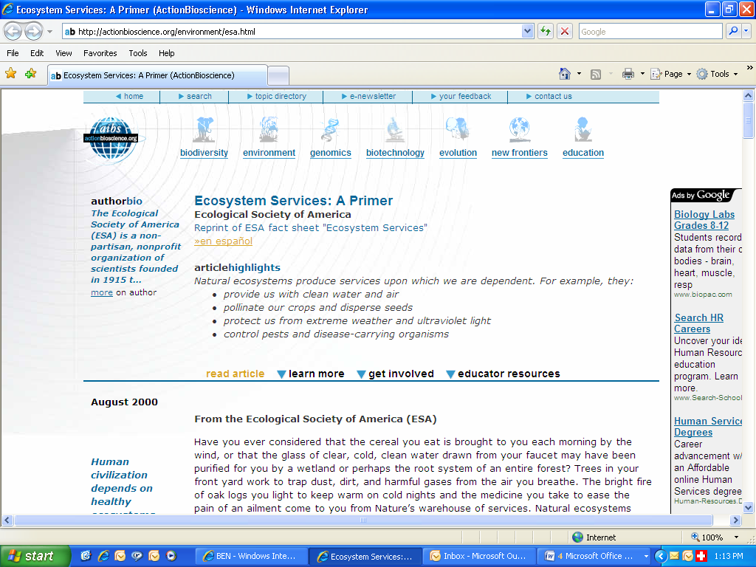

Slide 31
Forage survey techniques
Adapted from Ashton’s appendix

